Slide 1

MTIT ASSIGNMENT 03
Group ID : MTIT-020

Slide 2
OVERVIEW
INTRODUCTION
INDIVIDUAL CONTRIBUTION
DEFINITION AND ELABORATION ON THE MICROSERVICES
USAGE OF OCELOT API GATEWAY
HOW WE CAN AVOID HAVING MULTIPLE PORTS WITH THE GATEWAY WE IMPLEMENTED
SCREEN CAPTURES OF NATIVE SWAGGER URL OUTCOMES AND THE SAME WHEN WE ACCESS THEM USING THE API GATEWAY

Slide 3
INDIVIDUAL CONTRIBUTION
Registration Number | Student Name | Contribution
IT20029968 | Athukorala Y.J | Customer Management
IT19192024 | Jayawardhana E.H.K | Inventory Management
IT20147846 | Thennakoon S.U. | Order Management
IT20051020 | Shaminda W.G.T | Product Management

Slide 4
INTRODUCTION
We have decided to use Book Store Management System as our business domain.
There are four sub domains as microservices.
Customer Management
Inventory Management
Order Management
Product Management

Slide 5
01
DEFINITION AND ELABORATION ON THE MICROSERVICES

Slide 6
WHAT IS MICROSERVICE ?
A microservice architecture is a software architectural style in which an application is constructed as a collection of loosely connected, independently deployable services that communicate with one another via APIs.

Slide 7
MICROSERVICE CUSTOMER MANAGEMENT IT20029968
Customer management microservice is a component which is responsible for manage customer data such as name, address, phone by creating new records, Reading existing records, Updating existing records and Deleting them.

Slide 8
MICROSERVICE INVENTORY MANAGEMENT IT19192024
Inventory management microservice is a component which is responsible for manage inventory data by creating new records, Reading existing records, Updating existing records and Deleting them.

Slide 9
MICROSERVICE ORDER MANAGEMENT IT20147846
Order management microservice is a component which is responsible for manage order data by creating new records, Reading existing records, Updating existing records and Deleting them.

Slide 10
MICROSERVICE PRODUCT MANAGEMENT IT20051020
Product management microservice is a component which is responsible for manage product data by creating new records, Reading existing records, Updating existing records and Deleting them.

Slide 11
WHAT IS API GATEWAY ?
An API Gateway is a layer that manages API requests between client apps and backend services.
It serves as an entry point for API requests and manages a number of functions including routing, rate limitation, authentication, Logging and Monitoring and caching.
Customers can access multiple backend services using a standardized interface provided by API gateways, thereby making system maintenance and scalability easier.
OCELOT and Azure API Management are two examples of products used in API Gateway.

Slide 12
02
USAGE OF OCELOT API GATEWAY

Slide 13
Routing : Ocelot allows you to define routing rules that guide incoming API requests to the appropriate microservice endpoints based on parameters such as URL or HTTP verb, resulting in a single entry point for API requests and easy routing to multiple microservices depending on the requested functionality.
Handles authentication and authorization : Ocelot API Gateway can handle microservice authentication and authorization. This means you may secure your microservices behind the gateway and restrict access to only authorized users.
Enables load balancing: Load balancing for your microservices can be enabled using Ocelot API Gateway. This implies that traffic may be distributed uniformly throughout your microservices, which can help to prevent any one microservice from becoming overloaded.

Slide 14
Caching : Ocelot enables the configuration of caching for API responds which improves microservice performance by caching frequently requested data and reduces the workload on backend systems, which leads to lower latency and faster response times.
Protocol Transformation : Ocelot supports protocol transformation, which allows for the conversion of incoming request data between one protocol to another, enabling for the unified implementation of several API protocols, like transforming RESTful request types to GraphQL or gRPC requests.
Monitoring and Logging : Ocelot has logging and monitoring facilities that can monitor and analyze the API gateway's and underlying microservices' performance and usage, assisting in issue detection, resolution, usage pattern tracking, and performance insights.

Slide 15
03
AVOID HAVING MULTIPLE PORTS WITH THE GATEWAY THAT IMPLEMENTED

Slide 16
In a microservices architecture, an API gateway such as Ocelot provides a consistent entry point for external queries.
You may create routing rules for incoming requests in Ocelot, making it easier to govern external access to your microservices.
You may simplify your microservices architecture and focus on delivering value to your clients by using an API gateway like Ocelot.

Slide 17
04
SCREEN CAPTURES OF INDIVIDUAL COMPONENTS

Slide 18
FOLDER STRUCTURE

Slide 19
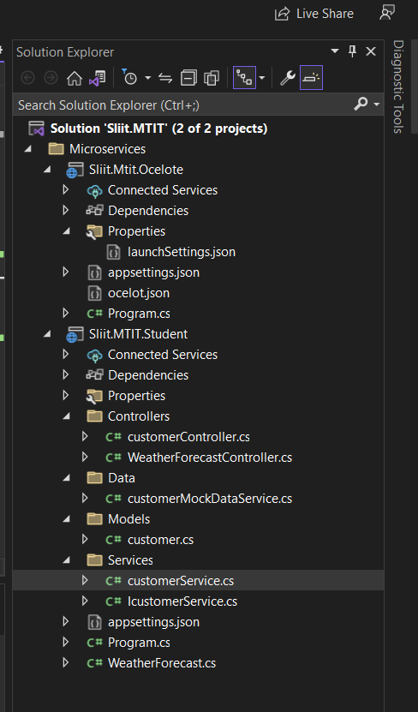
CUSTOMER MANAGEMENT IT20029968

Slide 20
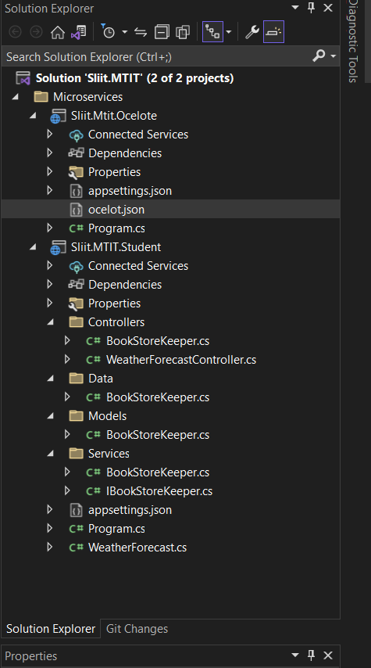
INVENTORY MANAGEMENT IT19192024

Slide 21
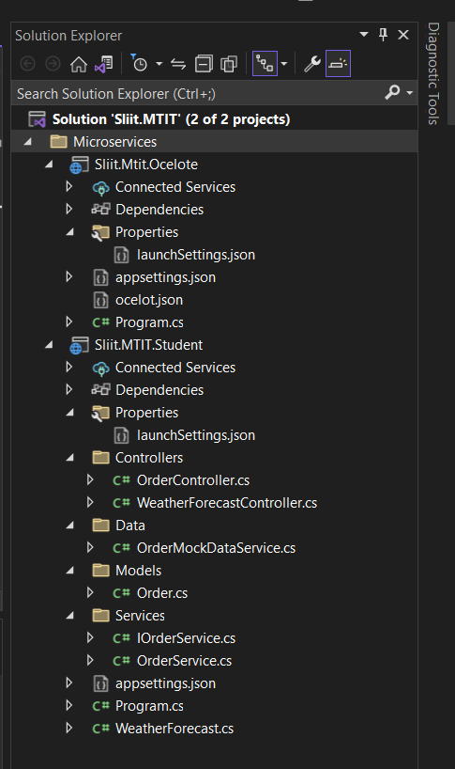
ORDER MANAGEMENT IT20147846

Slide 22
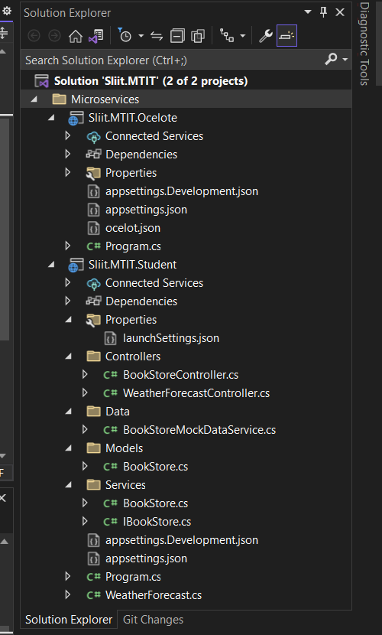
PRODUCT MANAGEMENT IT20051020

Slide 23
SWAGGER URL OUTCOMES

Slide 24
CUSTOMER MANAGEMENT IT20029968

Slide 25
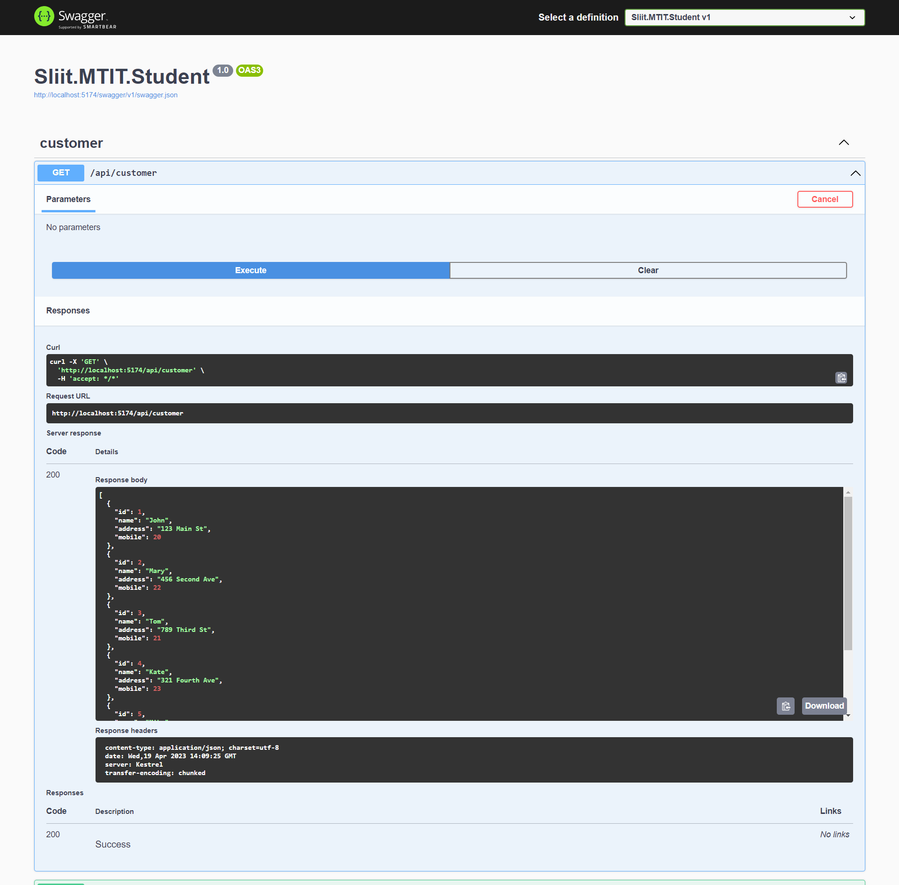
GET METHOD

Slide 26
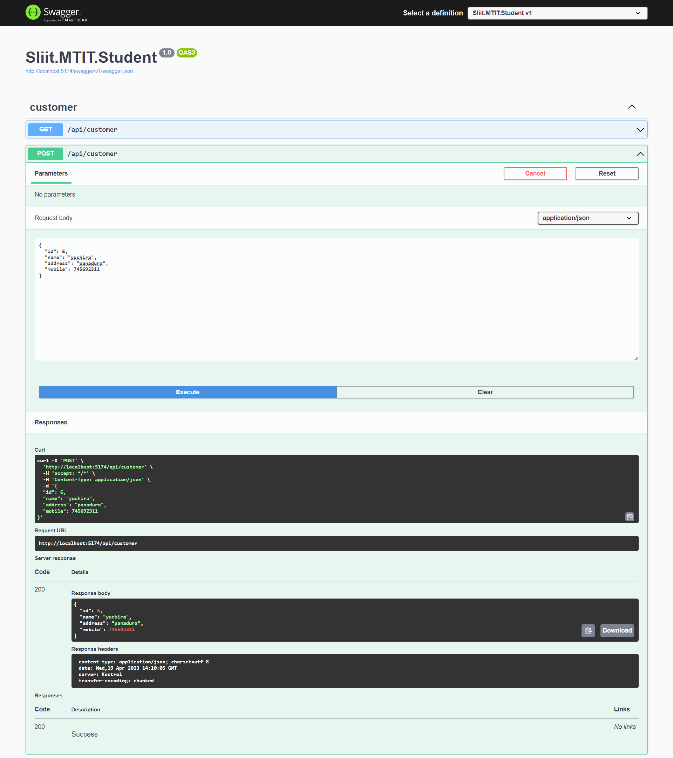
POST METHOD

Slide 27
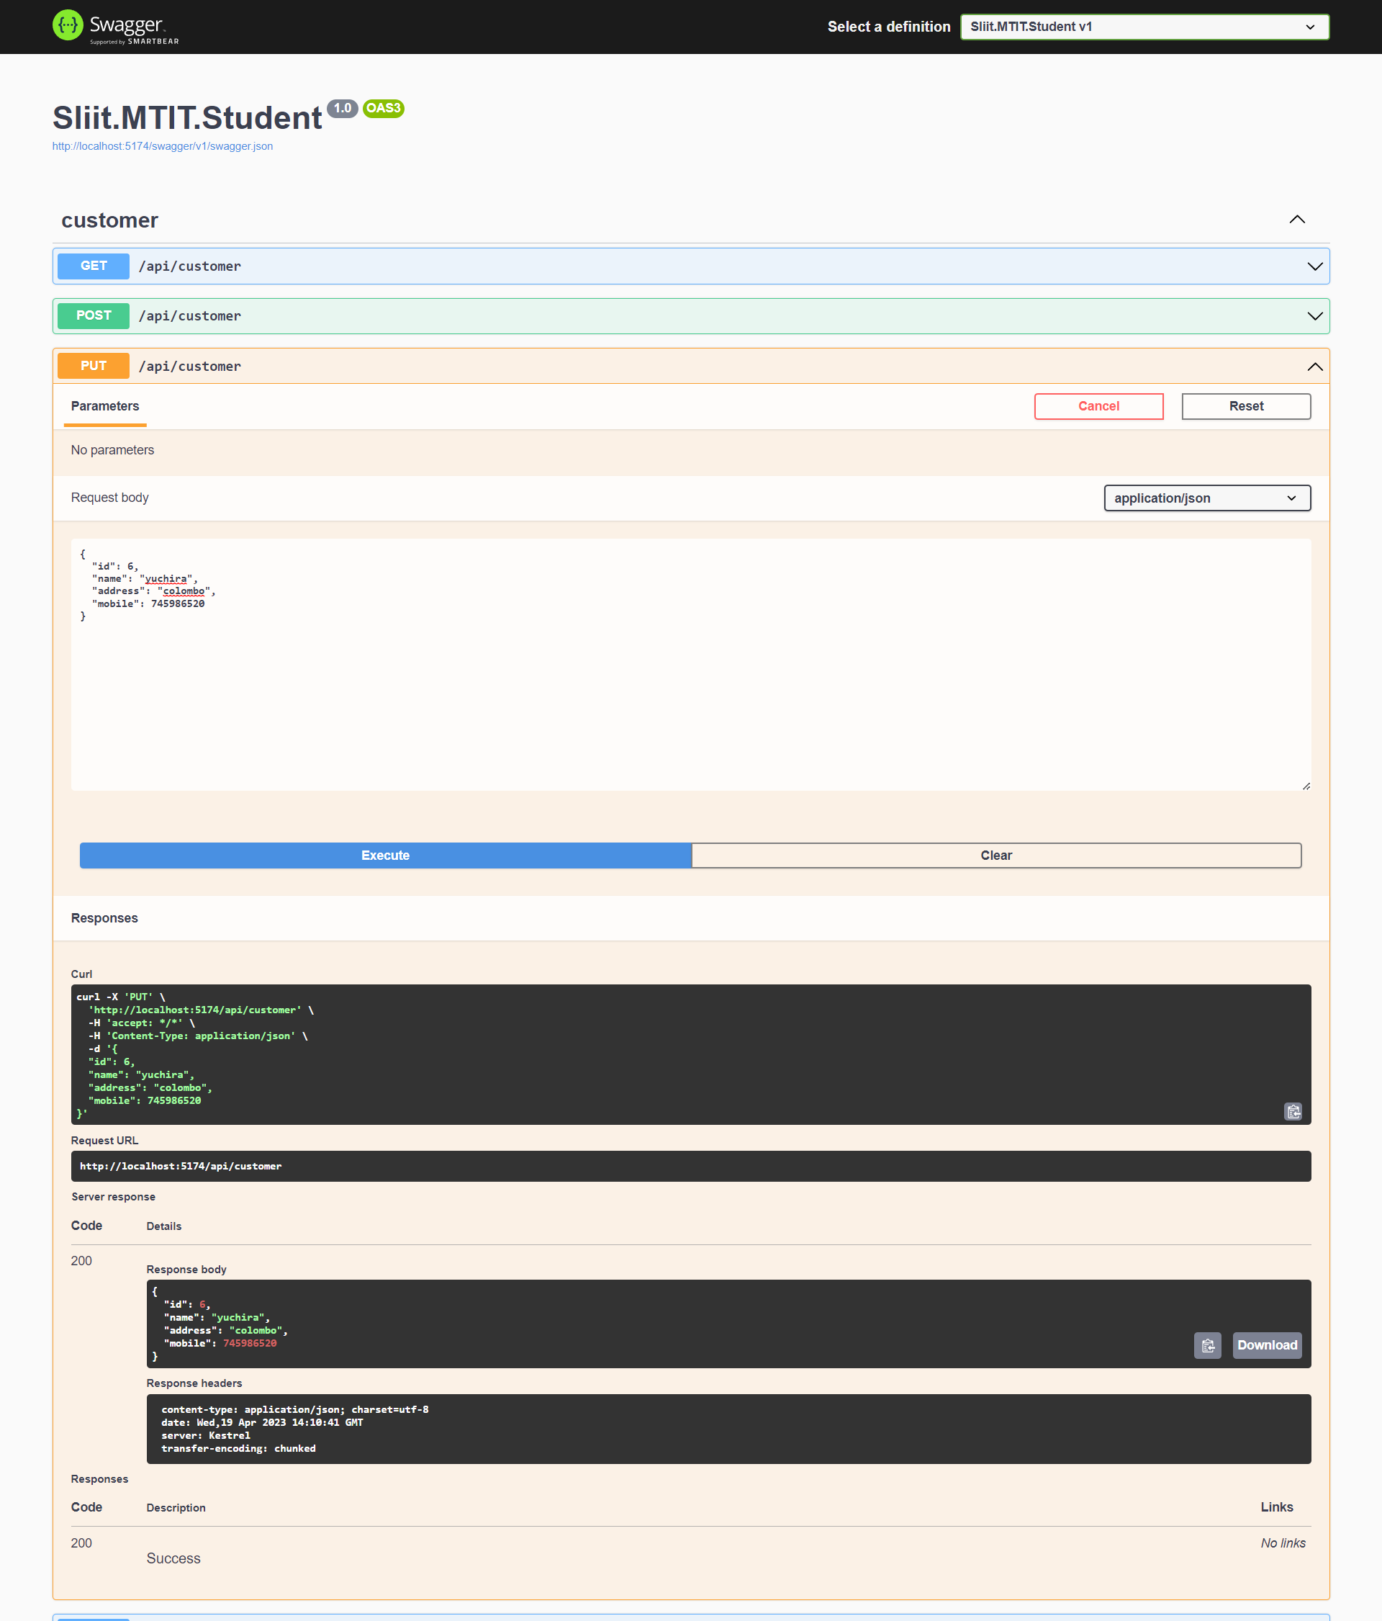
PUT METHOD

Slide 28
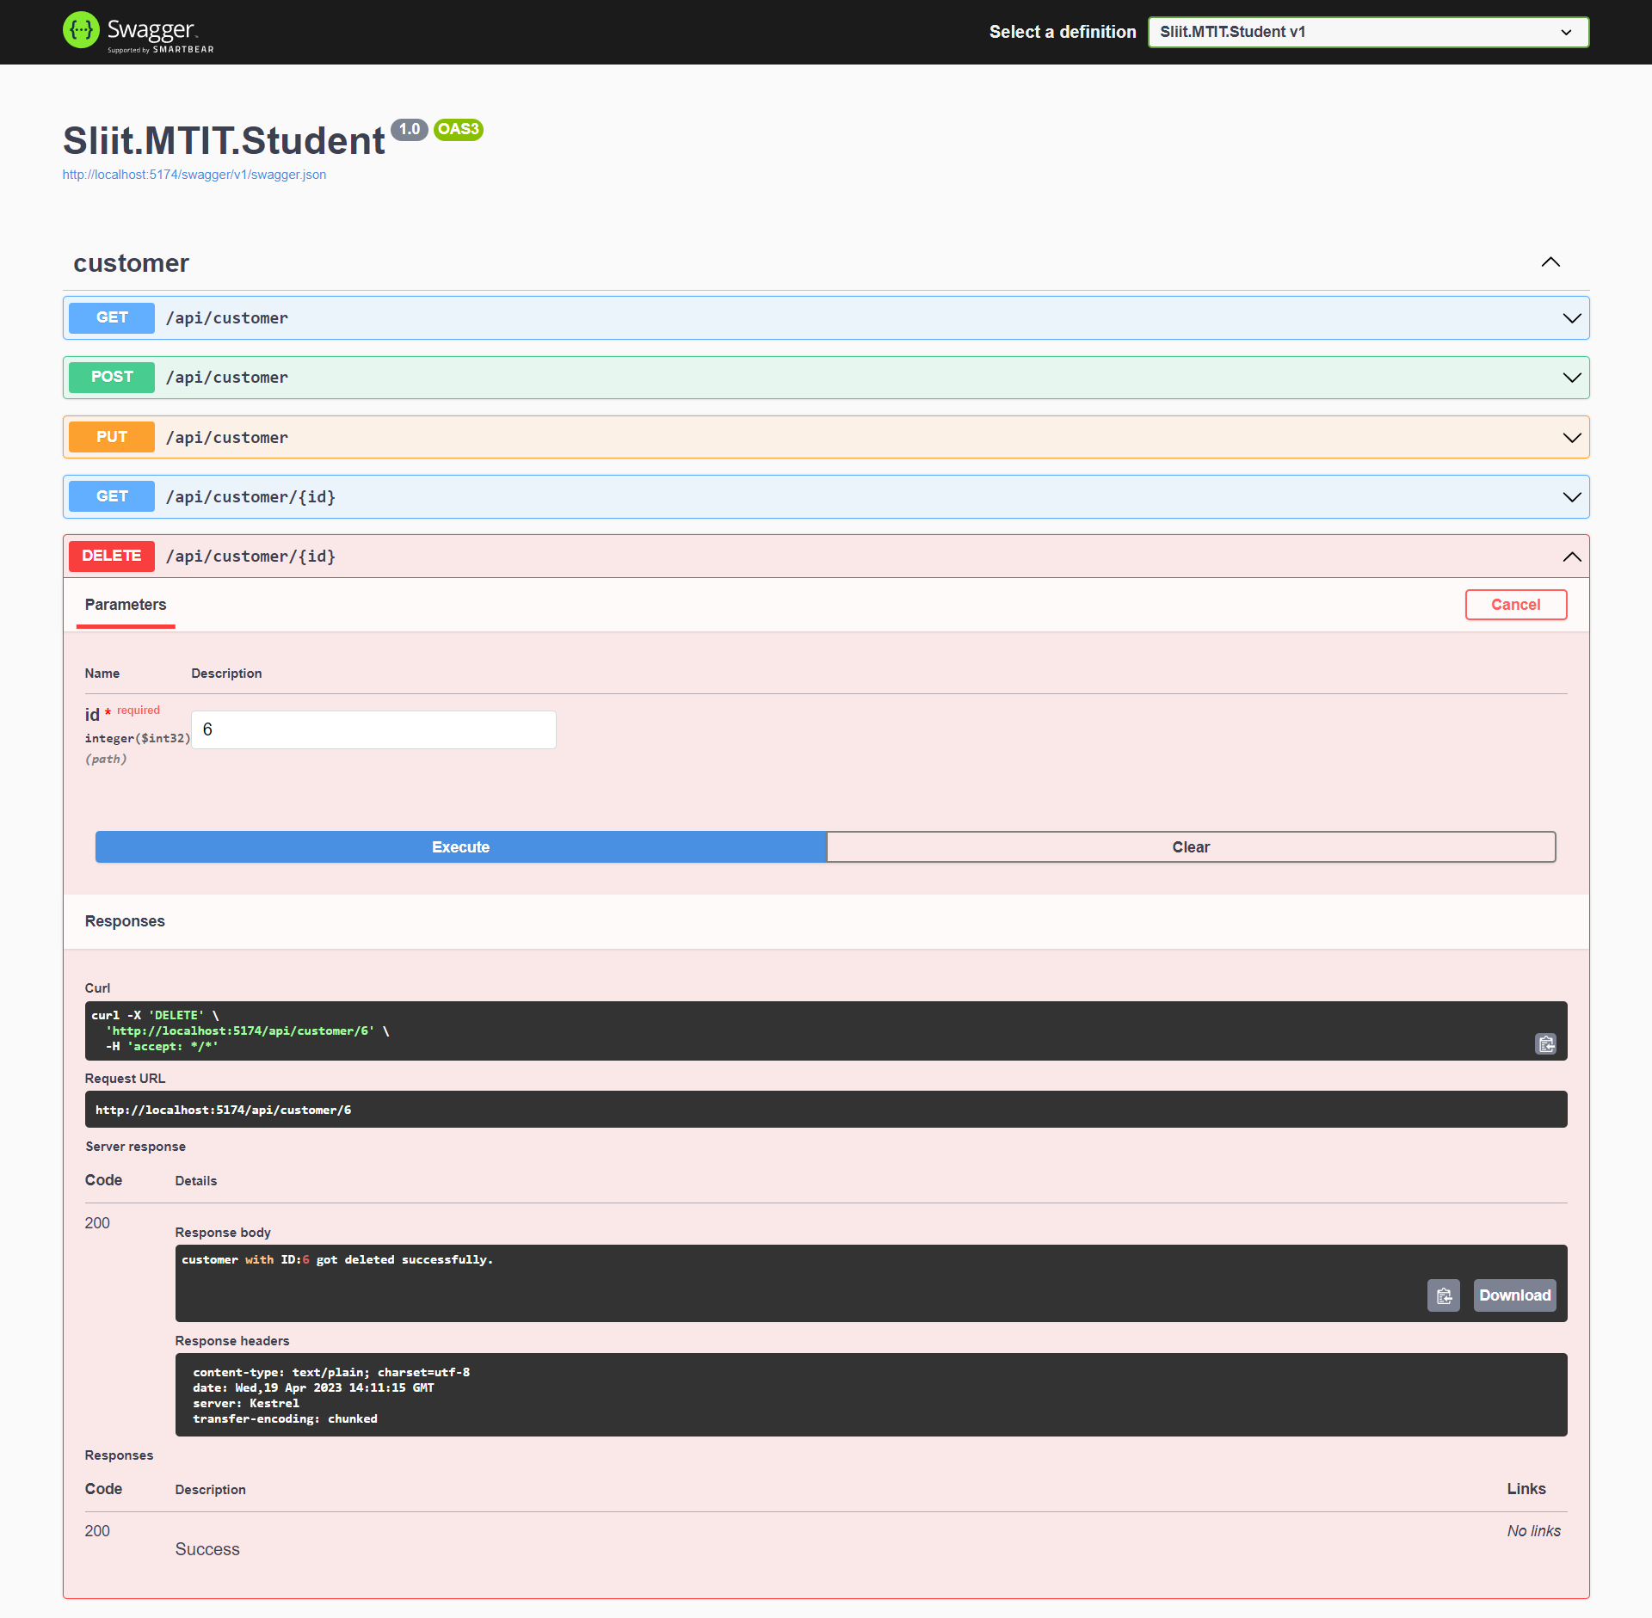
DELETE METHOD

Slide 29
INVENTORY MANAGEMENT IT19192024

Slide 30
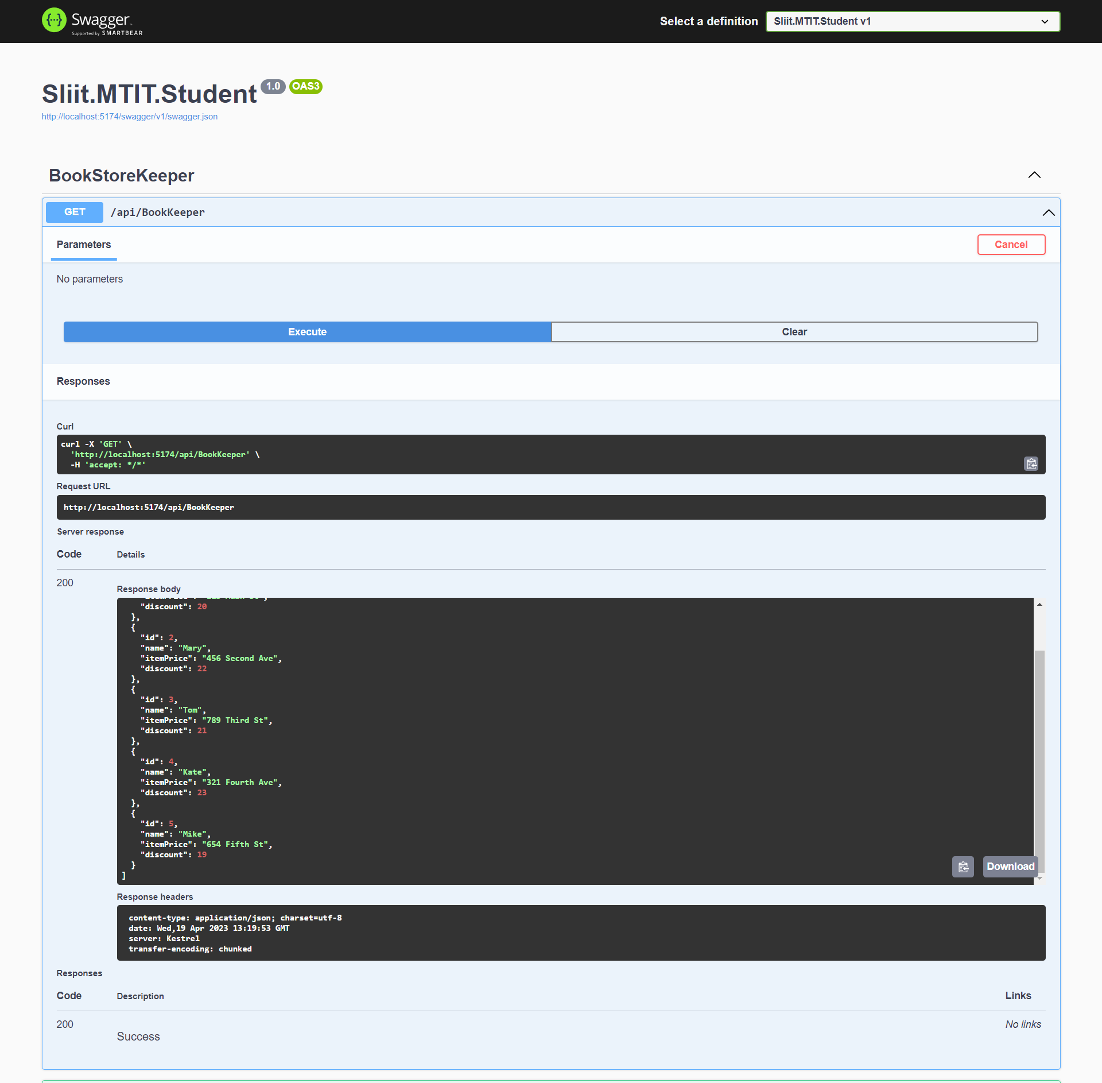
GET METHOD

Slide 31
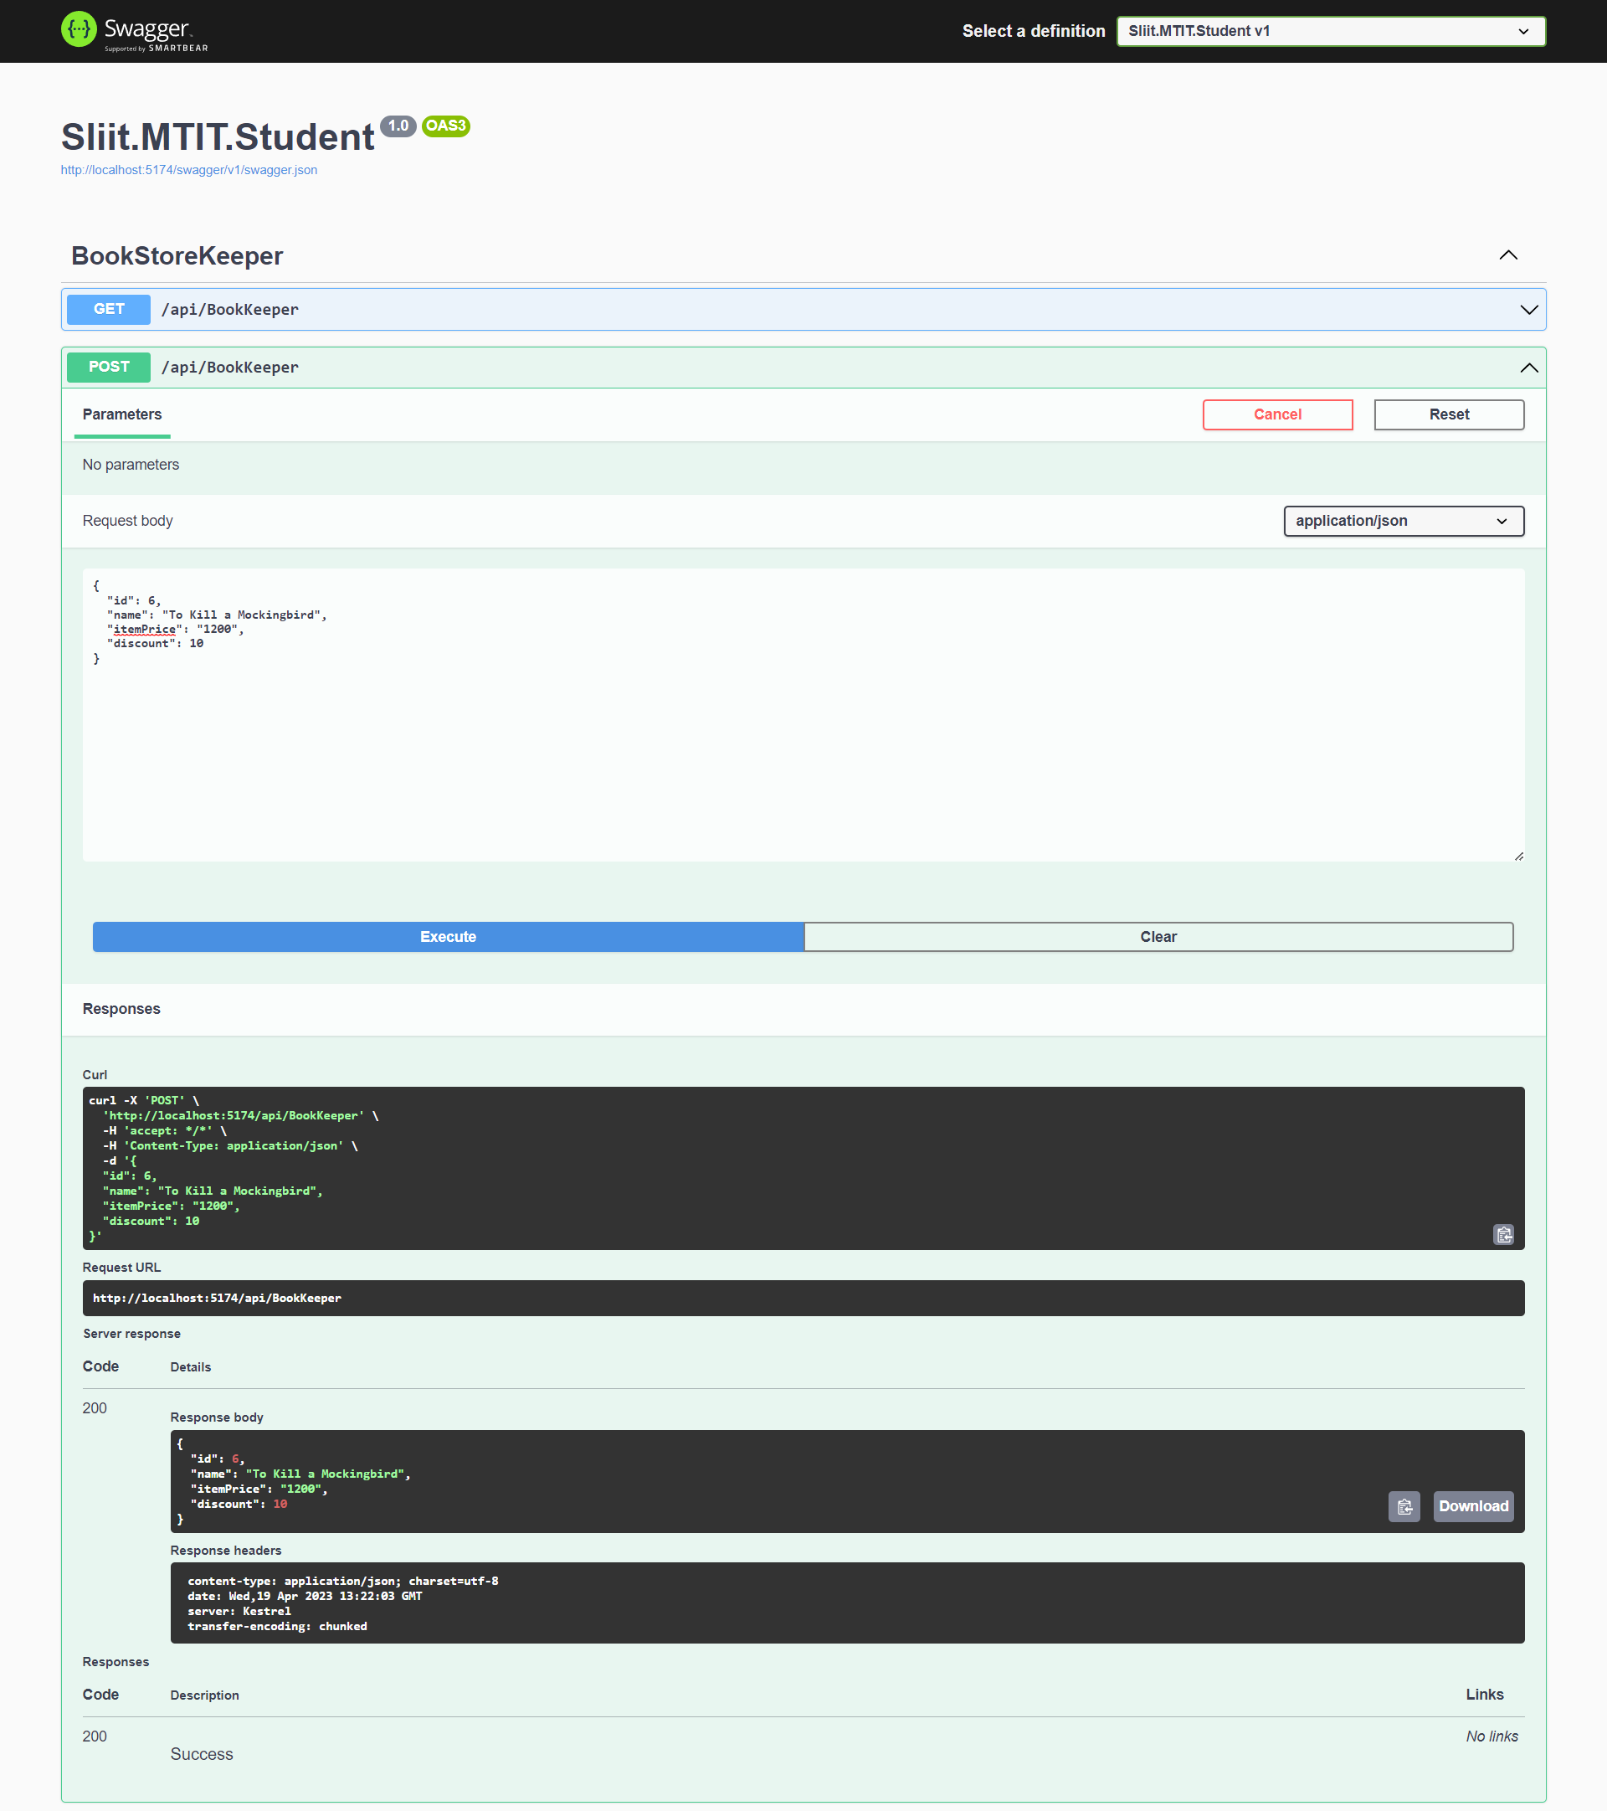
POST METHOD

Slide 32
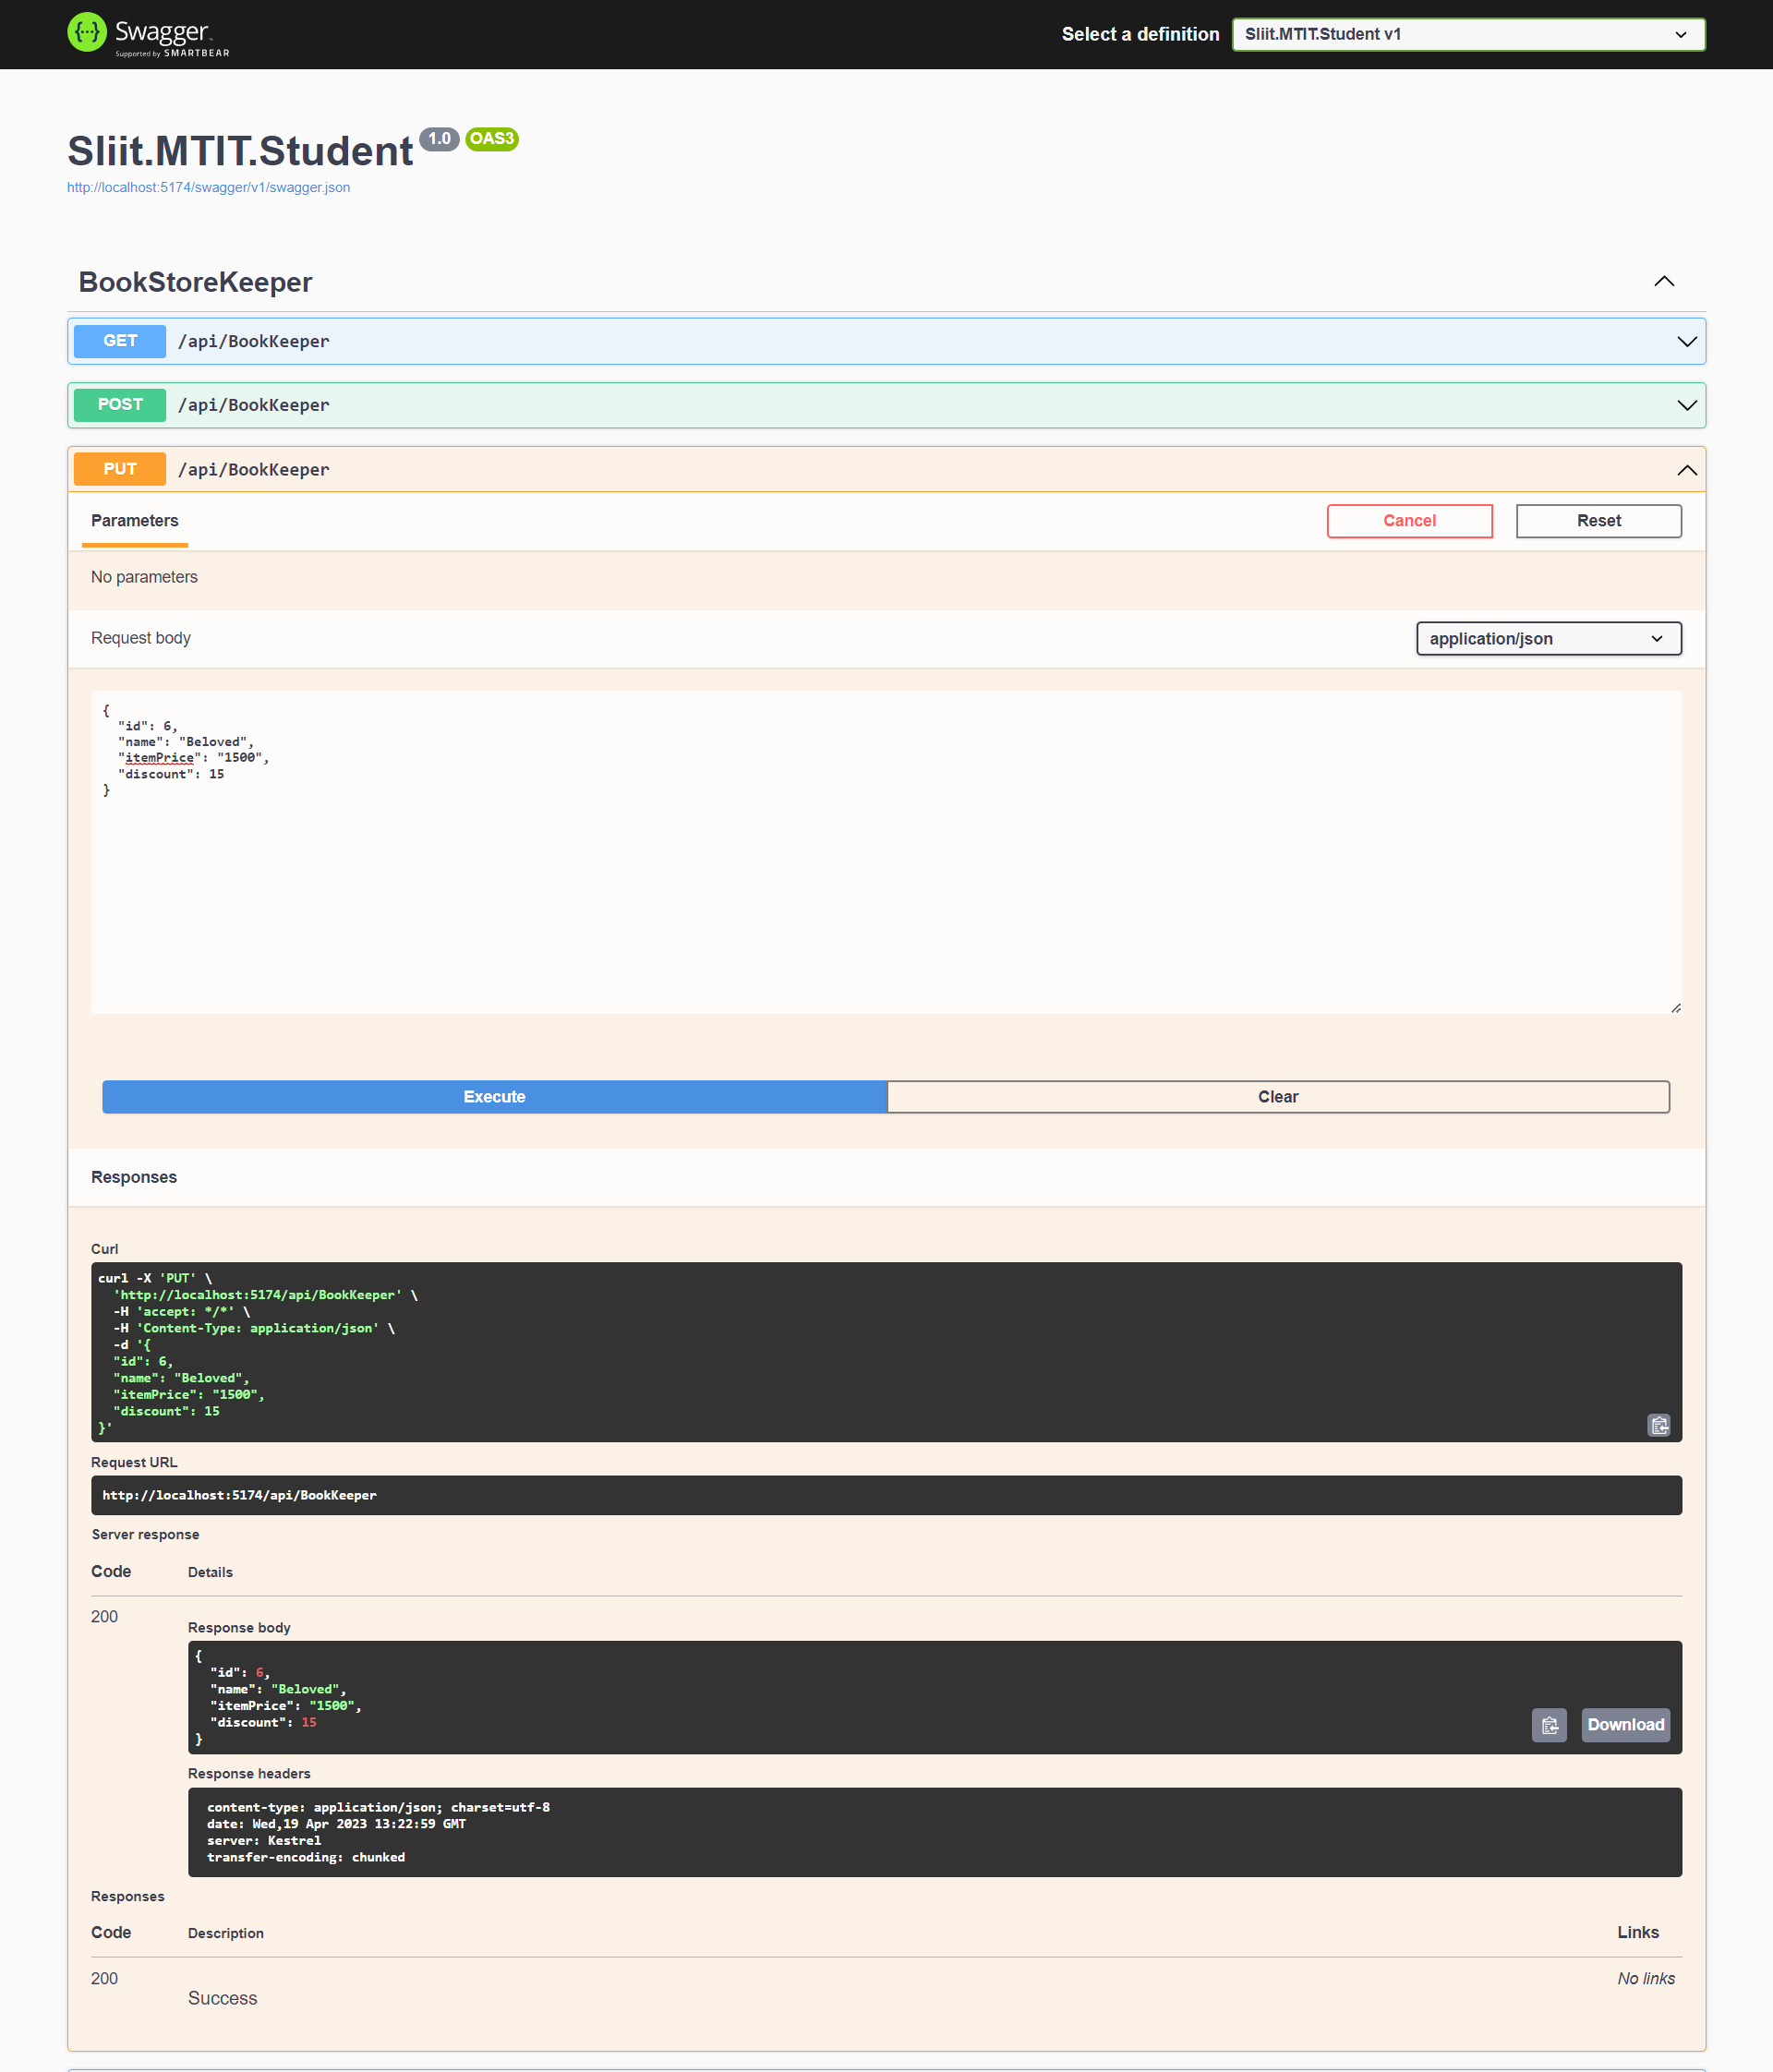
PUT METHOD

Slide 33
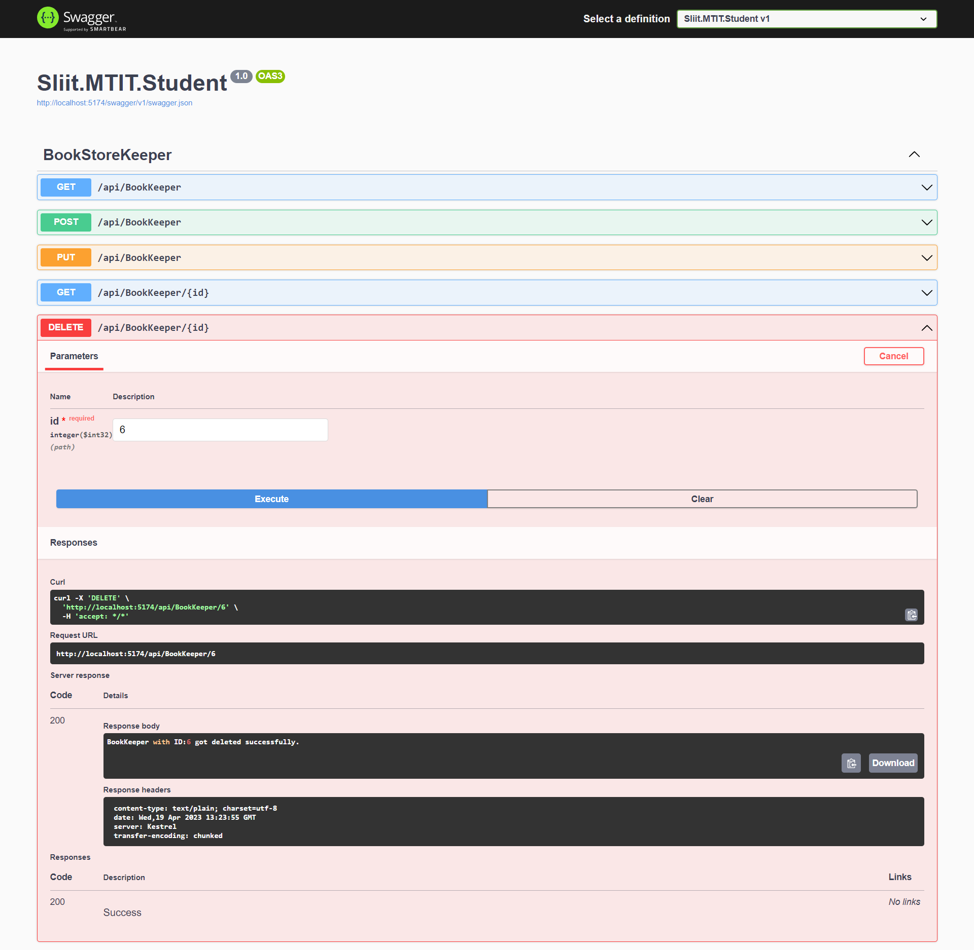
DELETE METHOD

Slide 34
ORDER MANAGEMENT IT20147846

Slide 35

GET METHOD

Slide 36
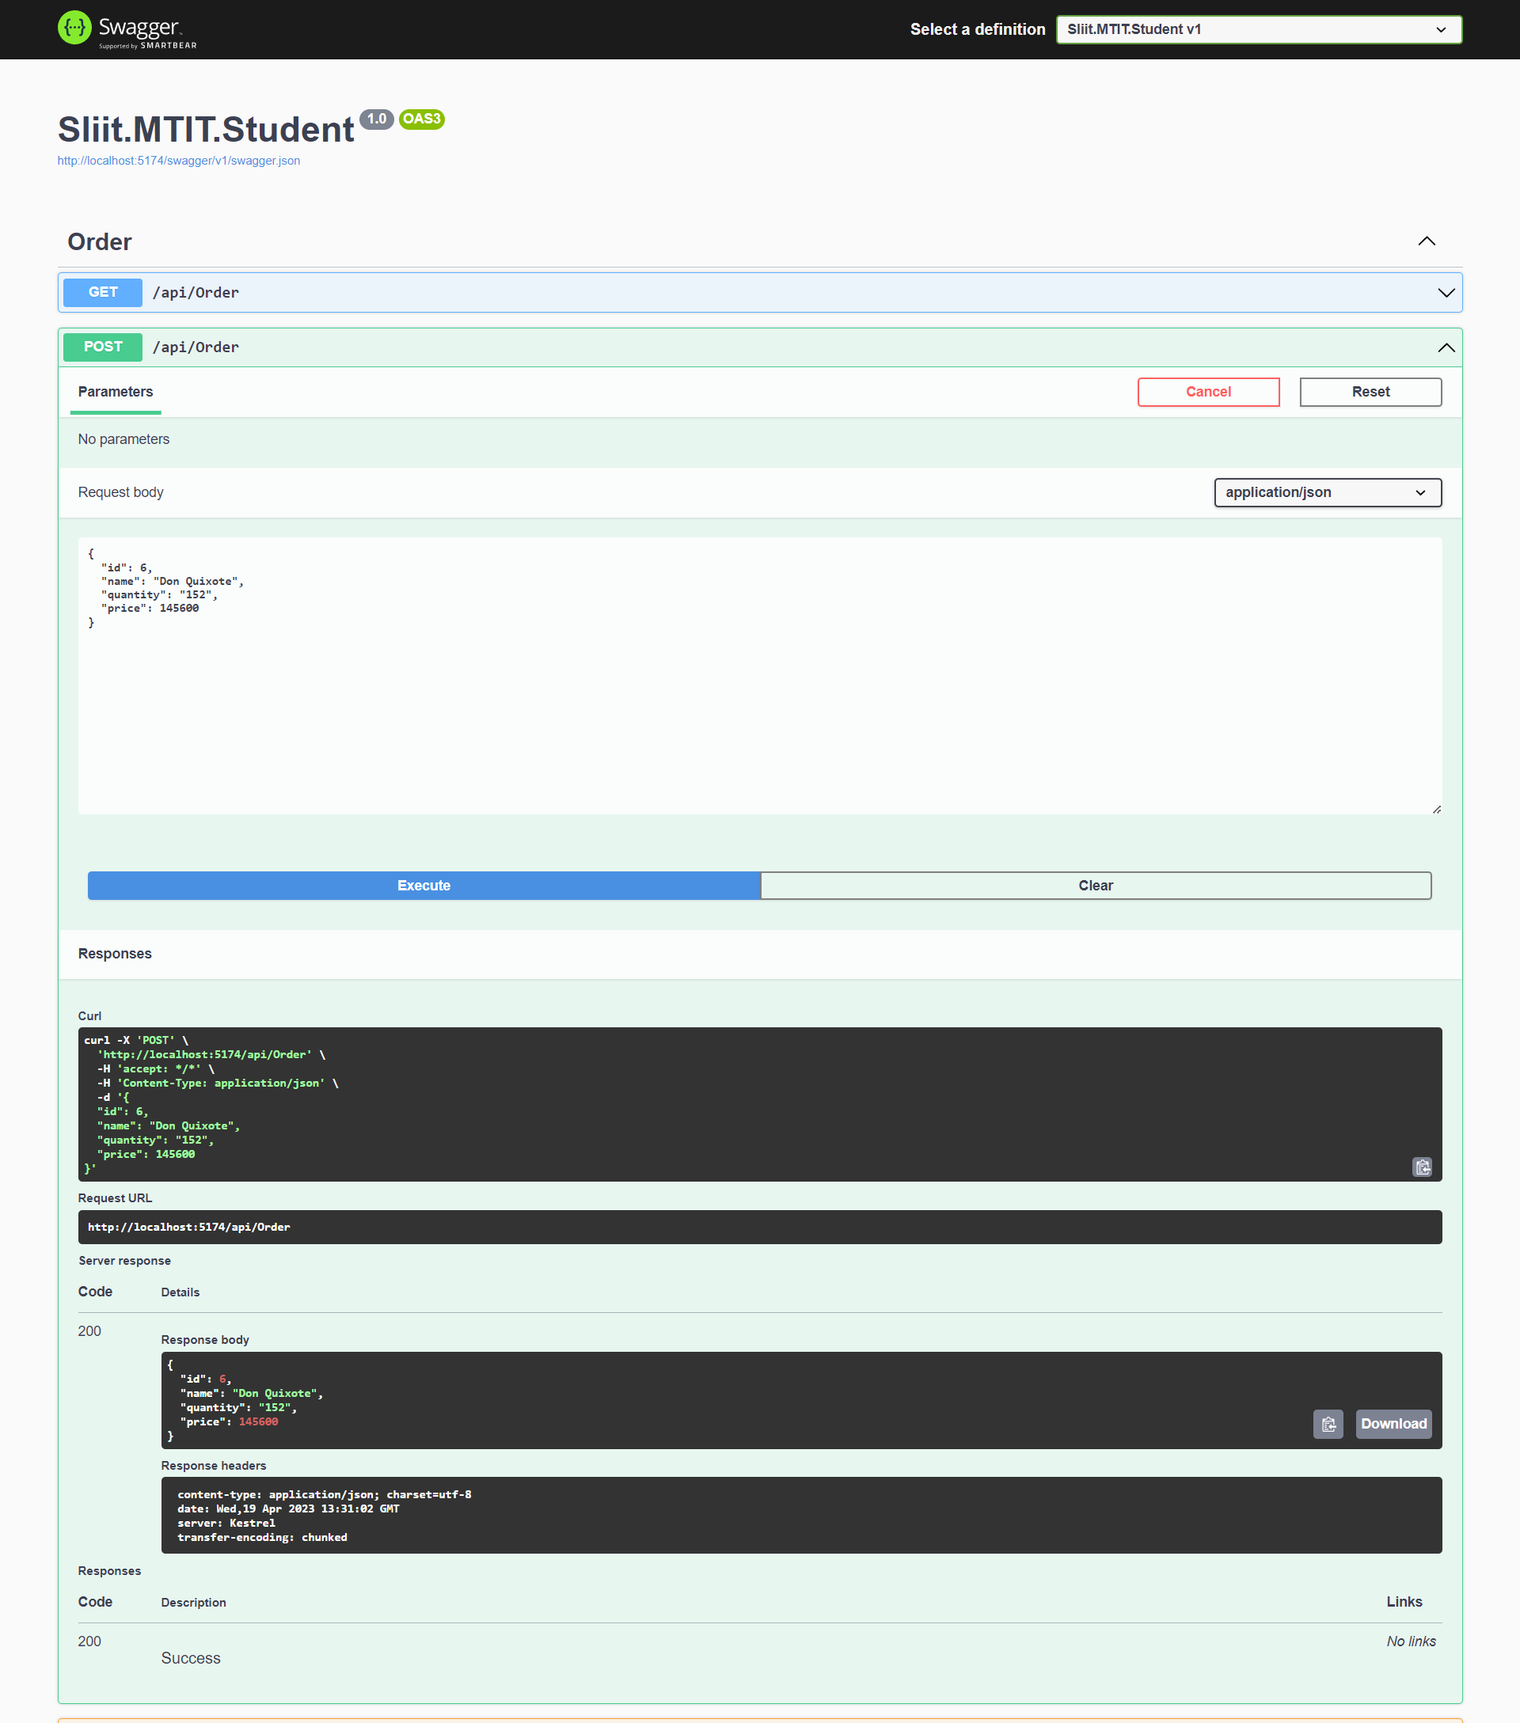
POST METHOD

Slide 37
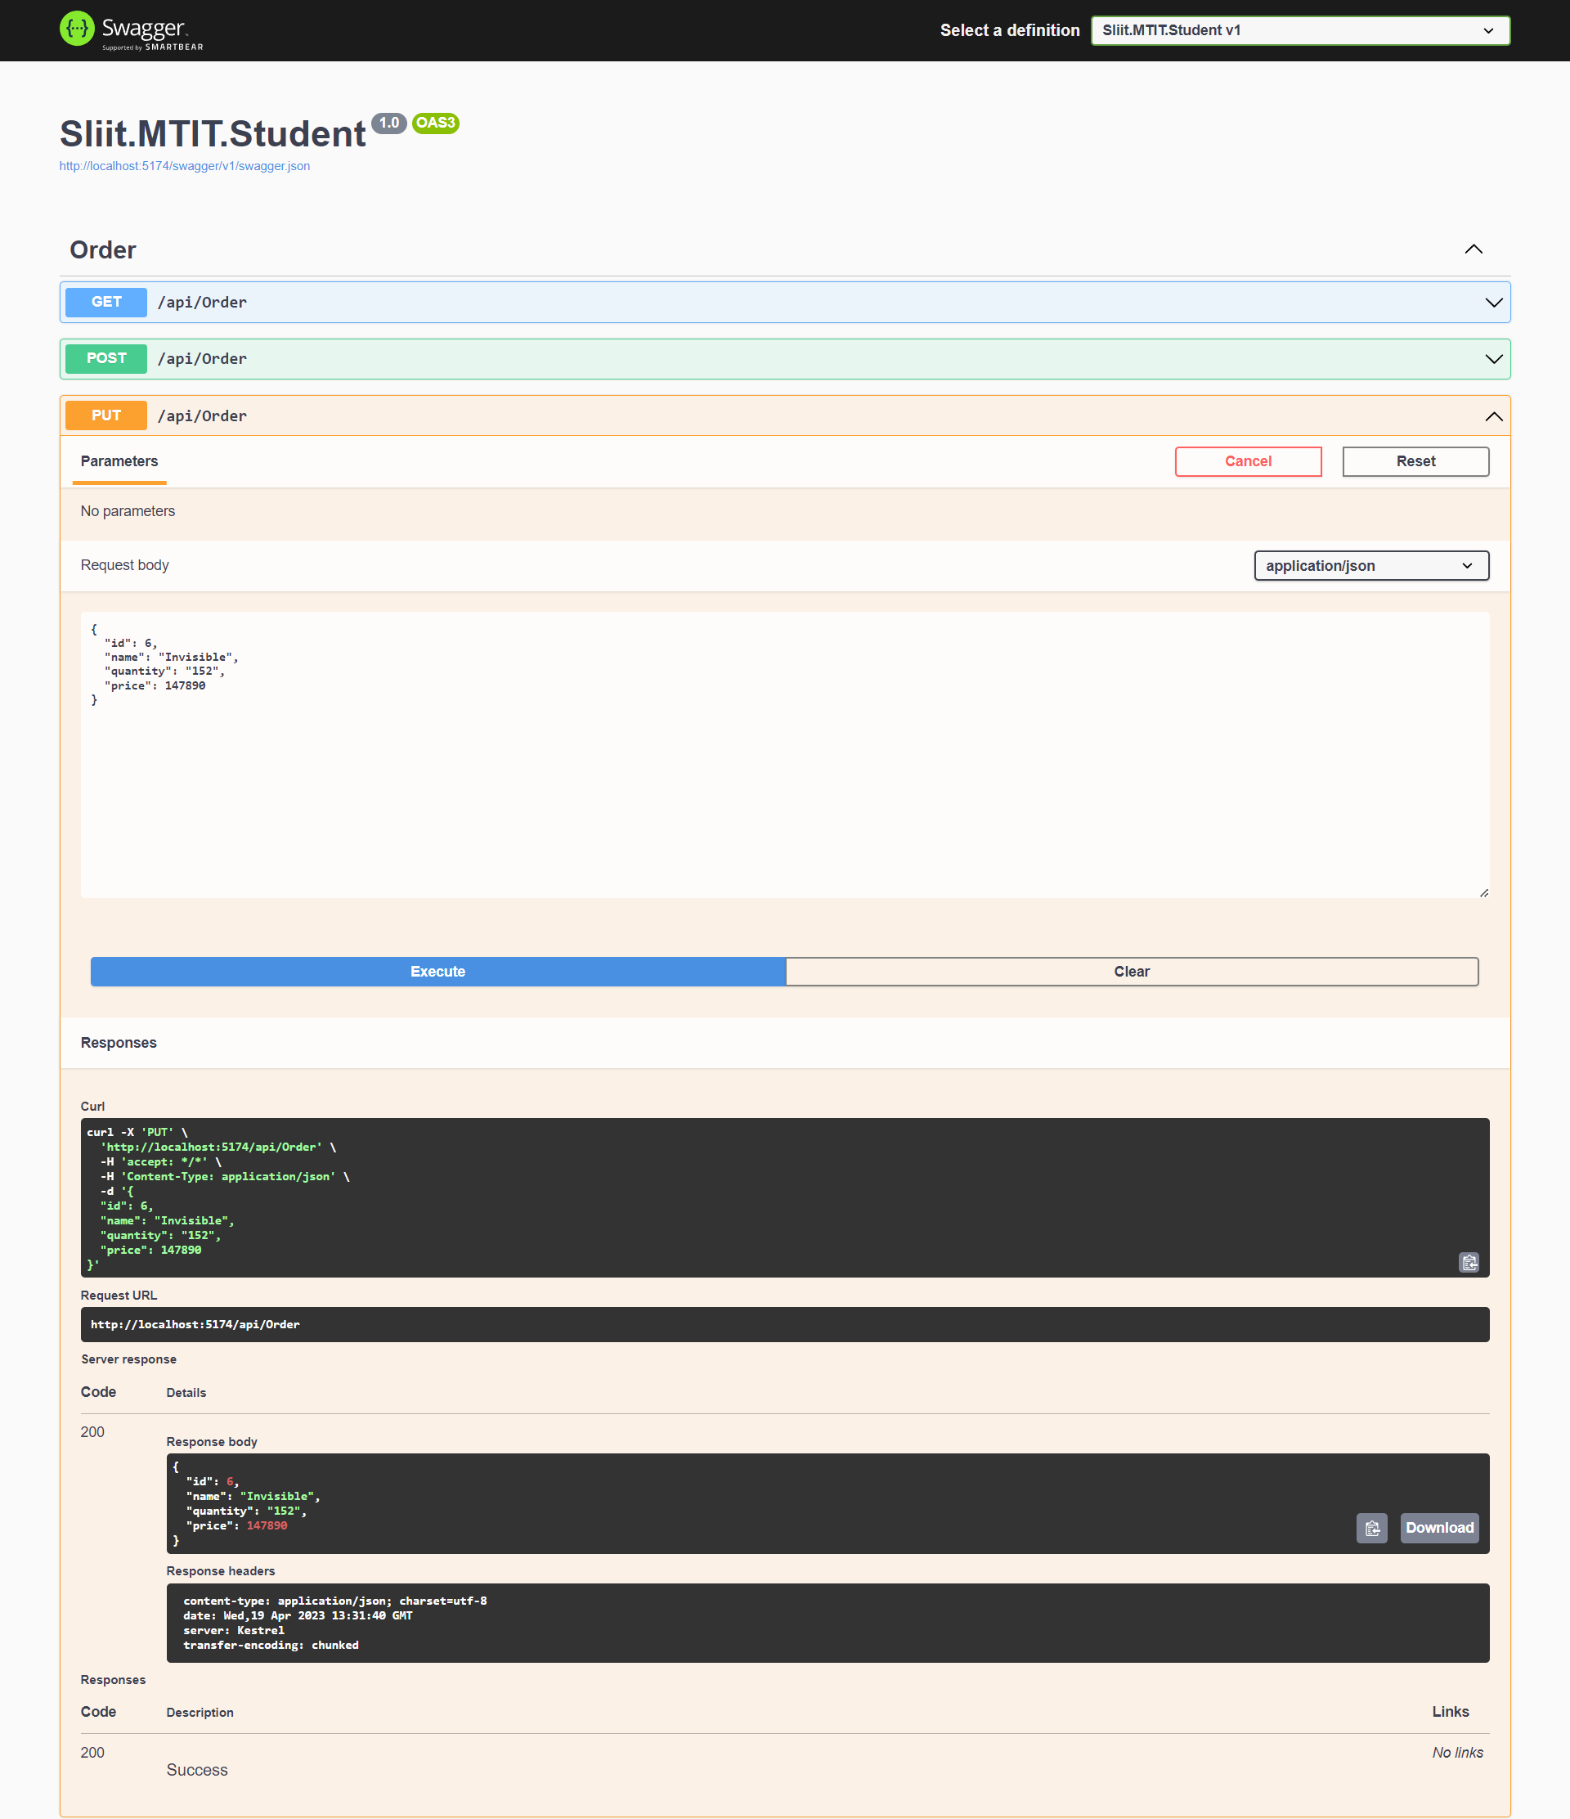
PUT METHOD

Slide 38

DELETE METHOD

Slide 39
PRODUCT MANAGEMENT IT20051020

Slide 40
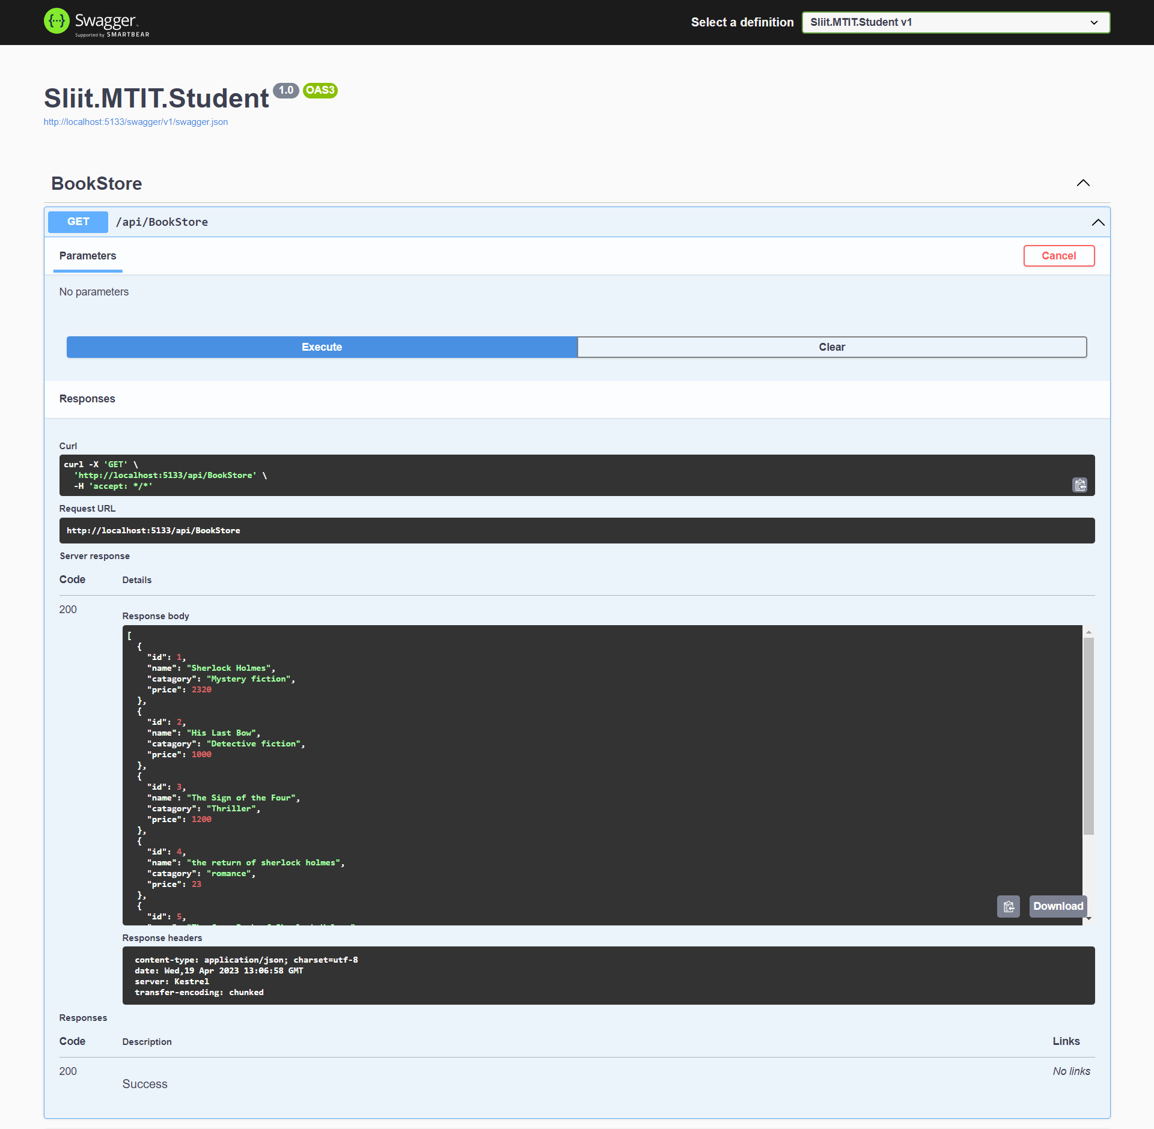
GET METHOD

Slide 41
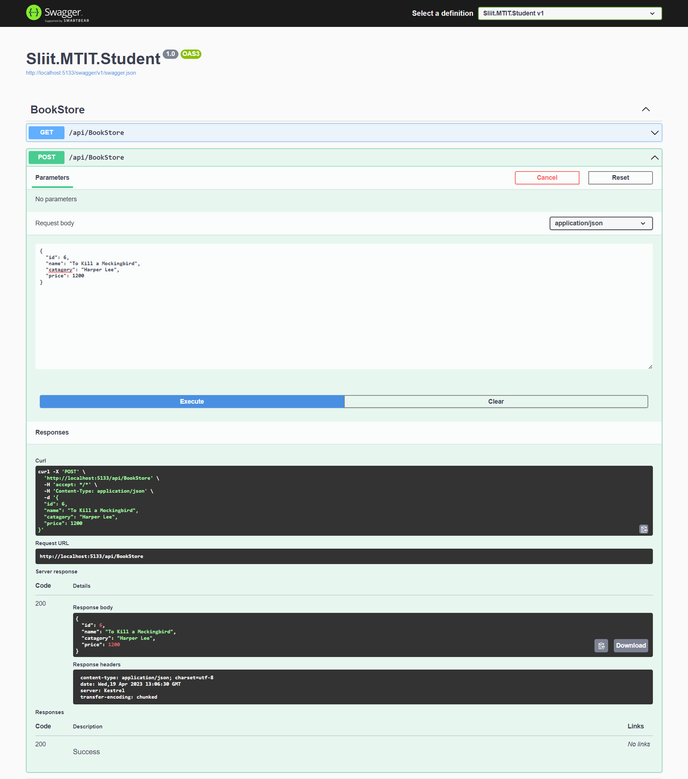
POST METHOD

Slide 42
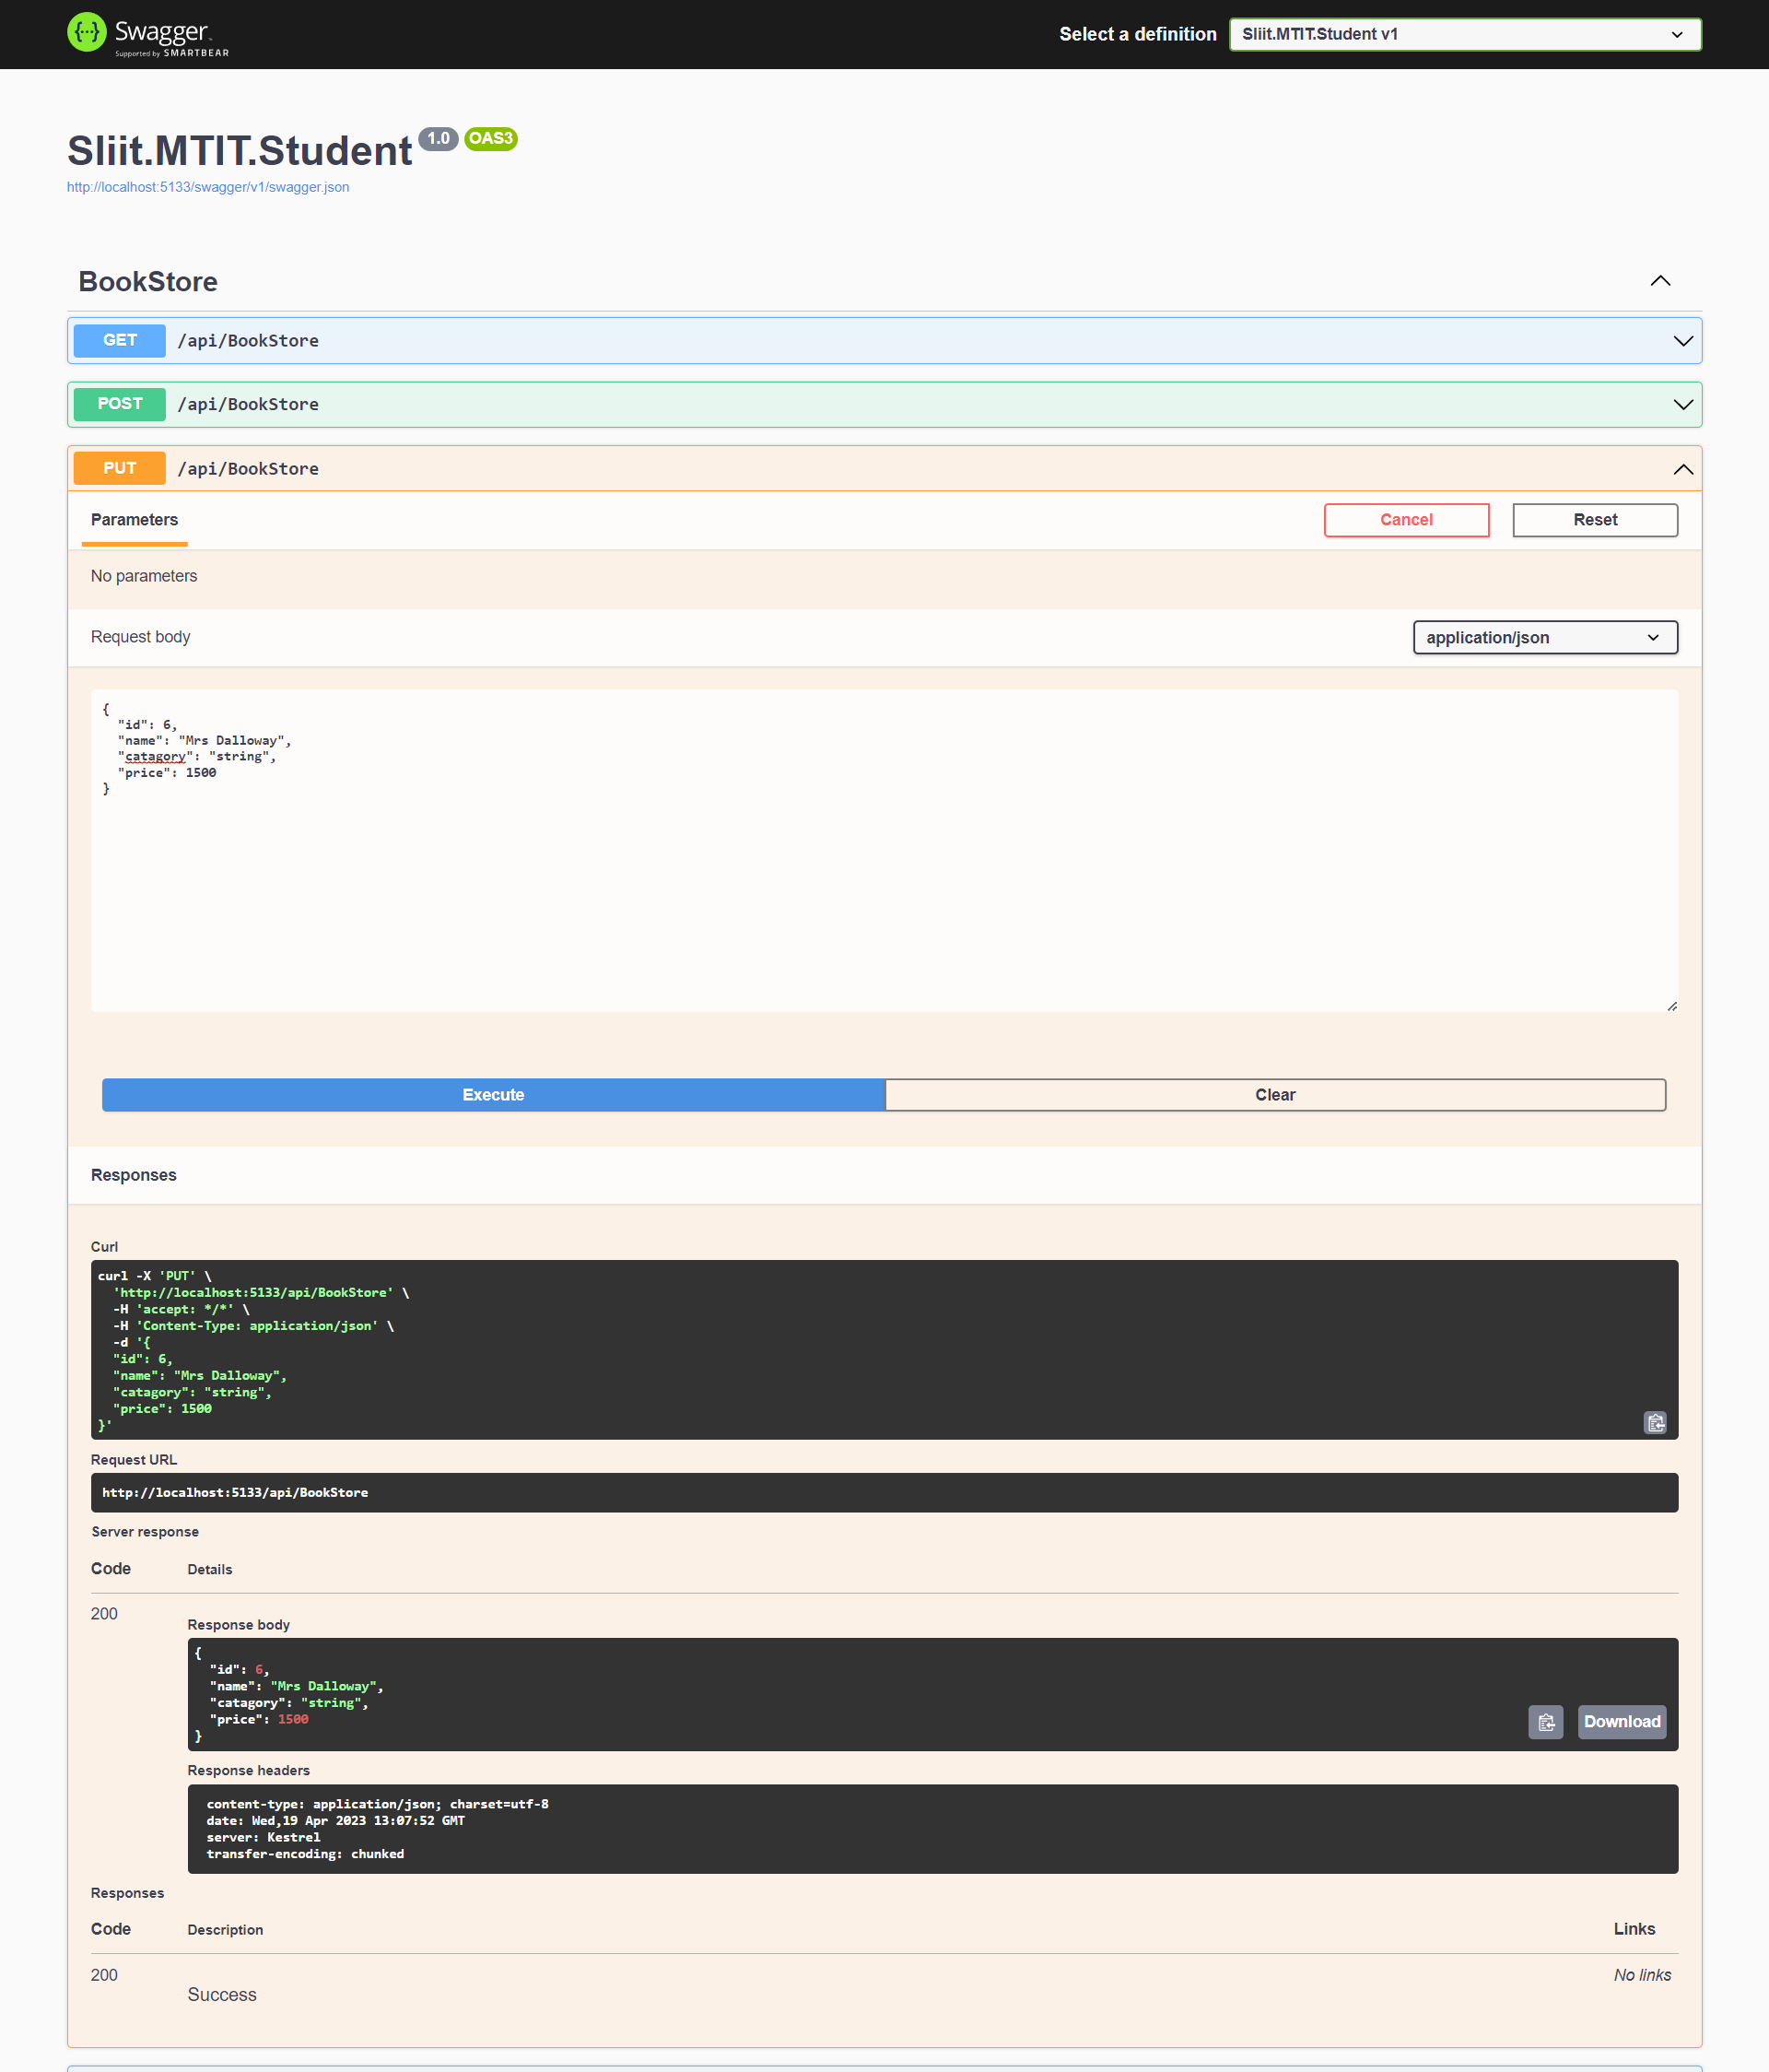
PUT METHOD

Slide 43
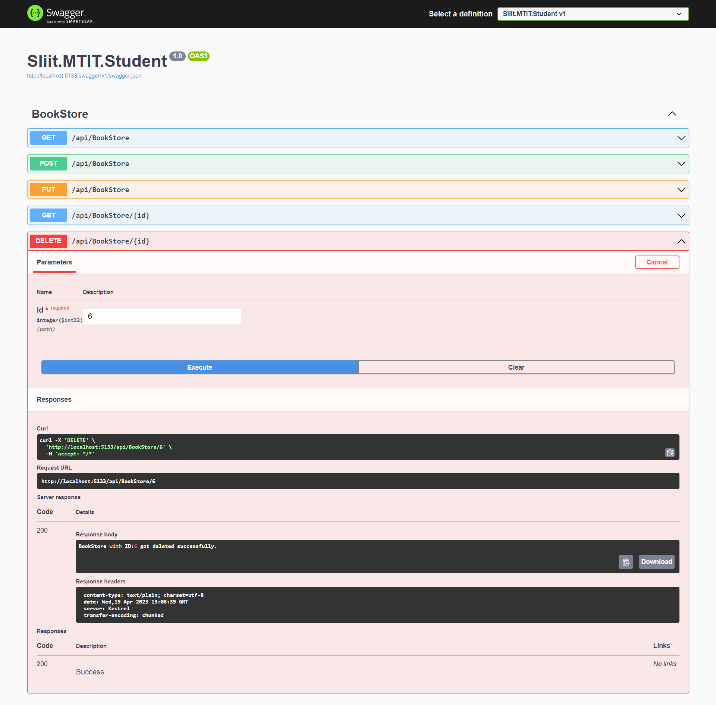
DELETE METHOD

Slide 44
UPSTREAM AND DOWNSTREAM

Slide 45
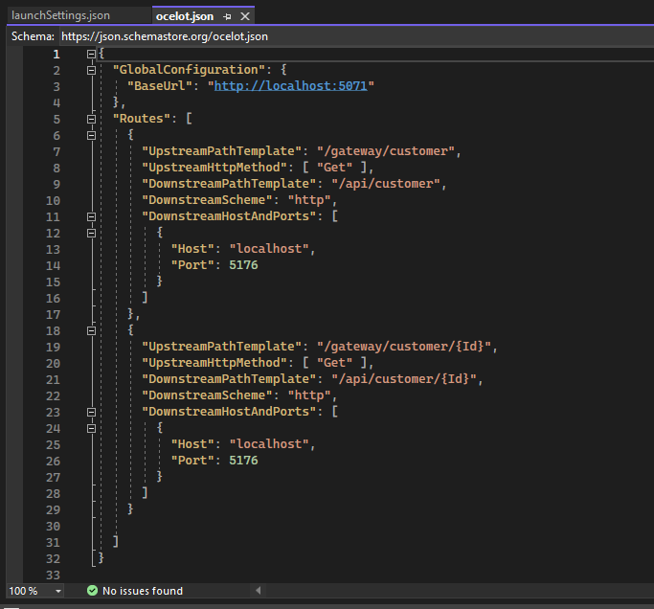
CUSTOMER MANAGEMENT IT20029968
ocelot.json

Slide 46
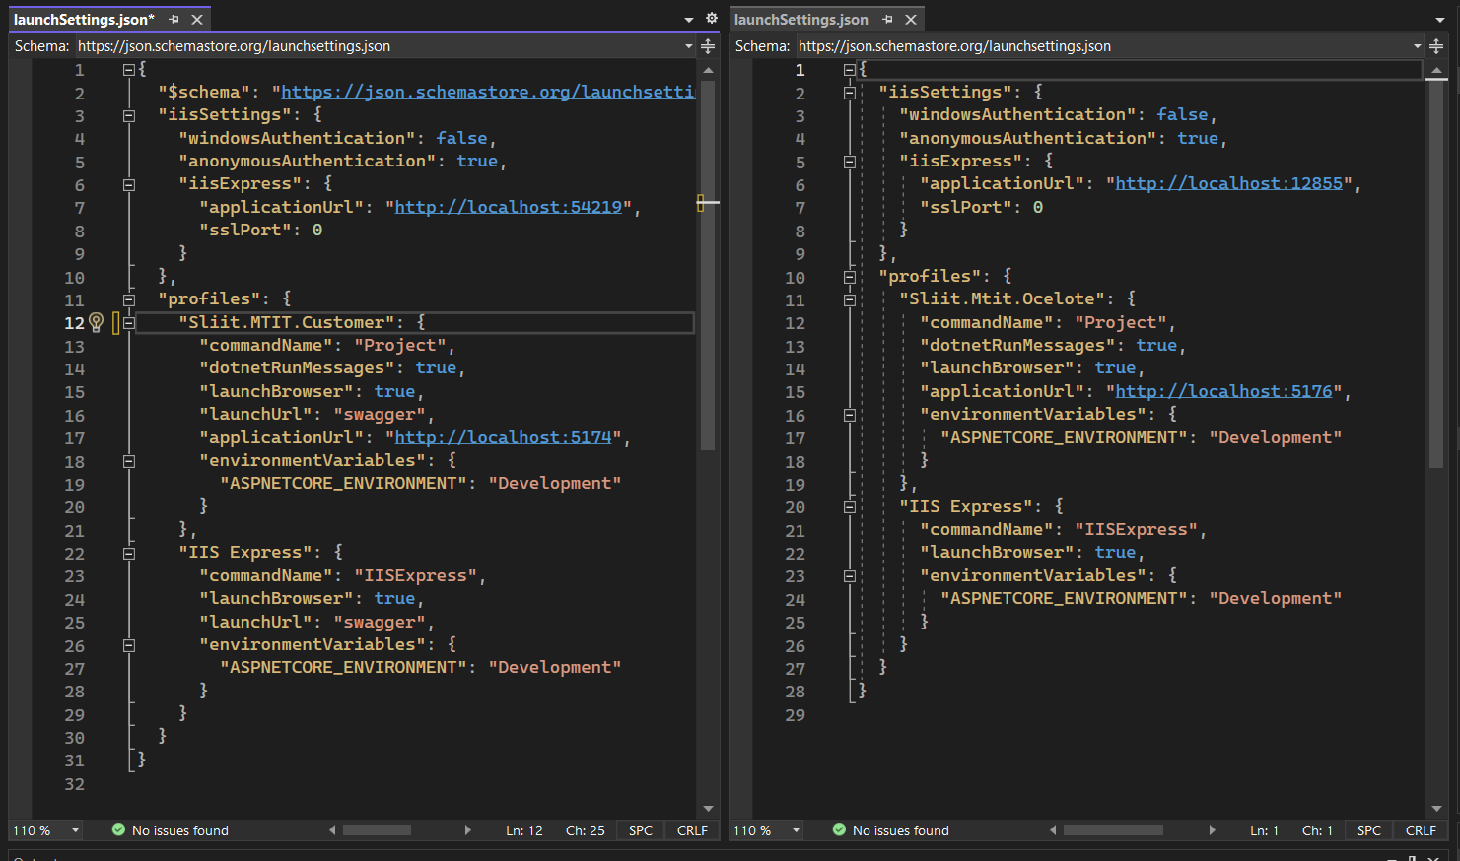
launchSettings.json

Slide 47
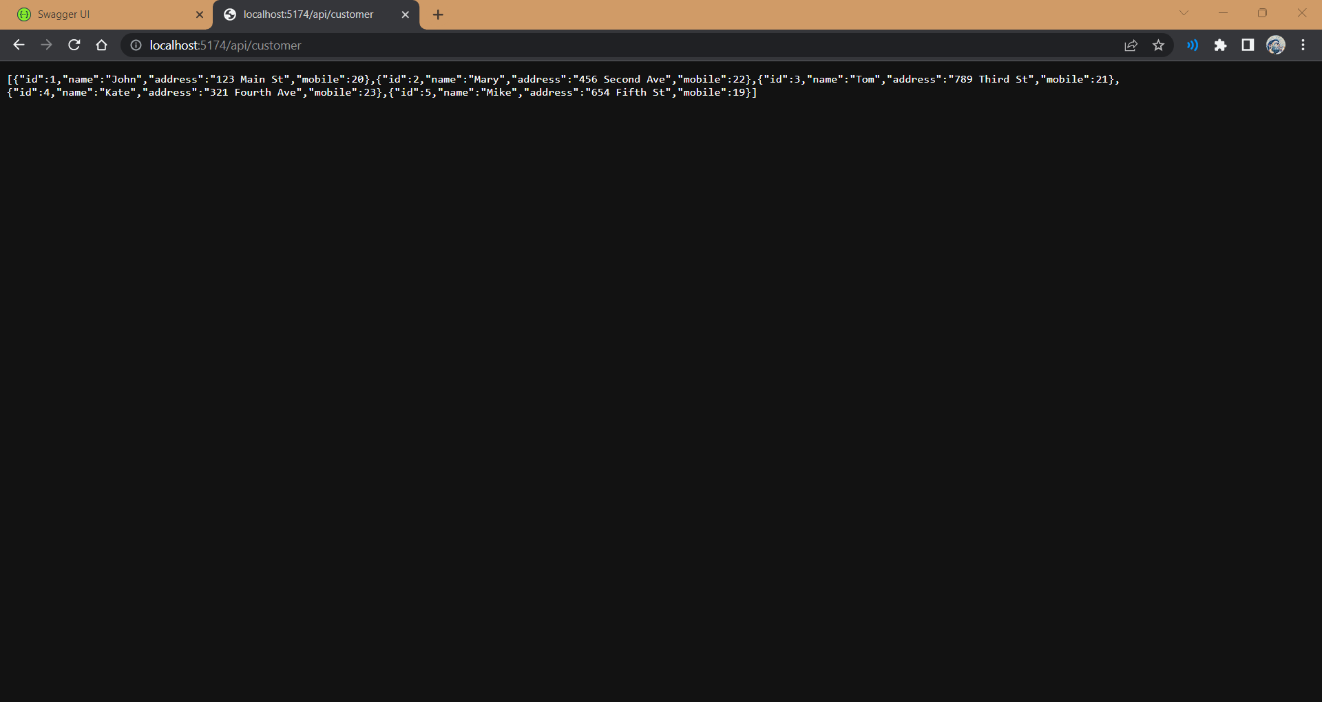
Output

Slide 48
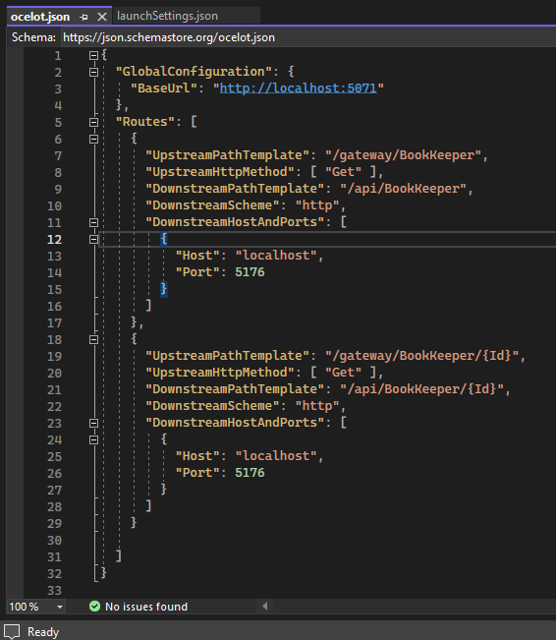
INVENTORY MANAGEMENT IT19192024
ocelot.json

Slide 49
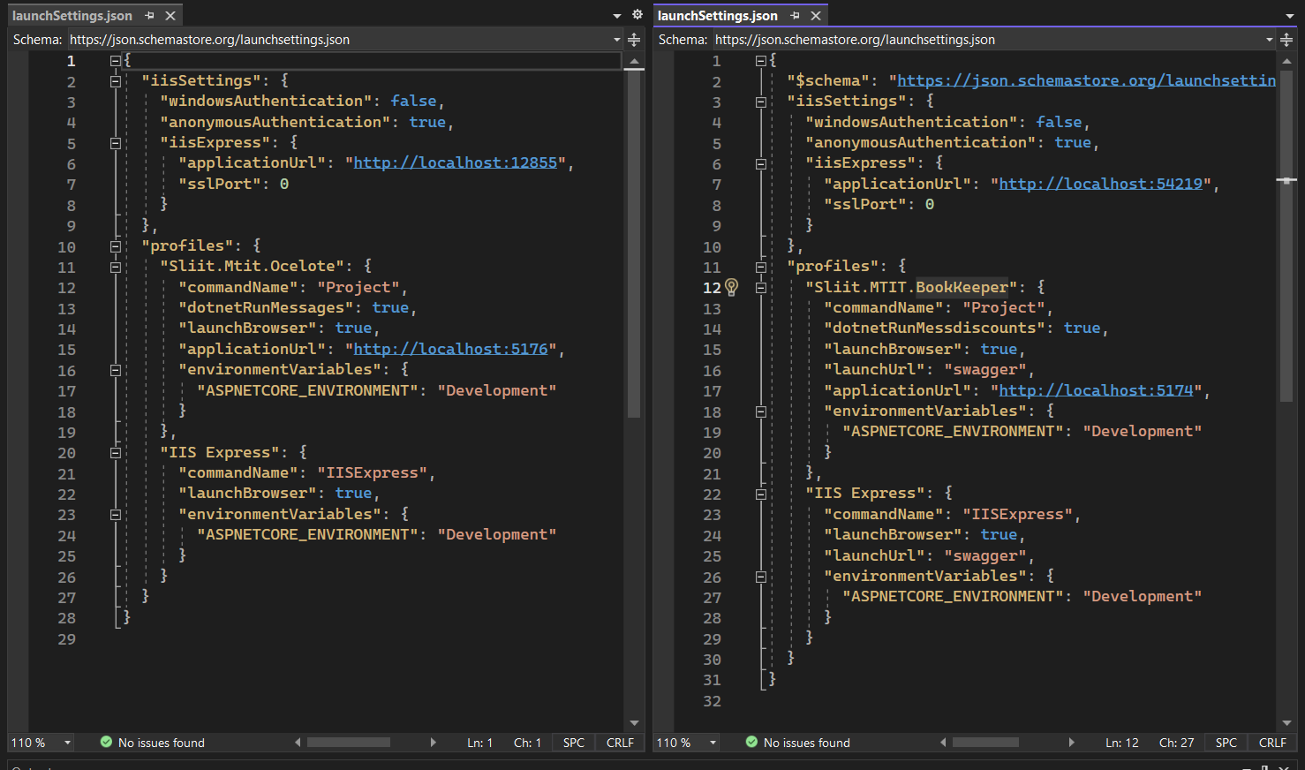
launchSettings.json

Slide 50

Output

Slide 51
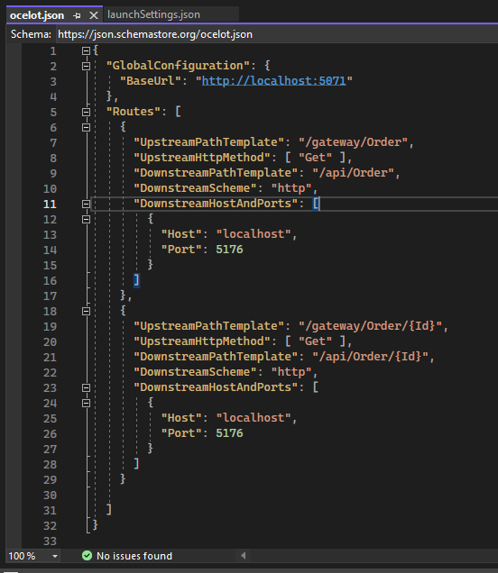
ORDER MANAGEMENT IT20147846
ocelot.json

Slide 52
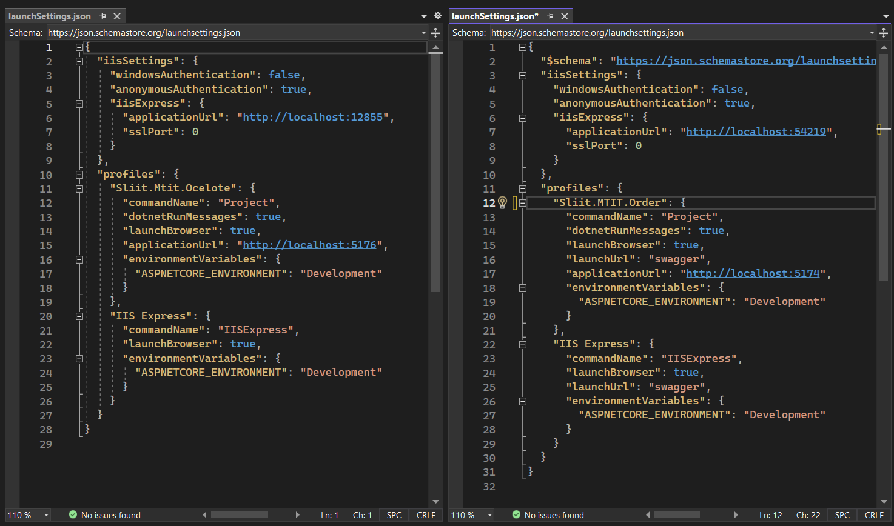
launchSettings.json

Slide 53
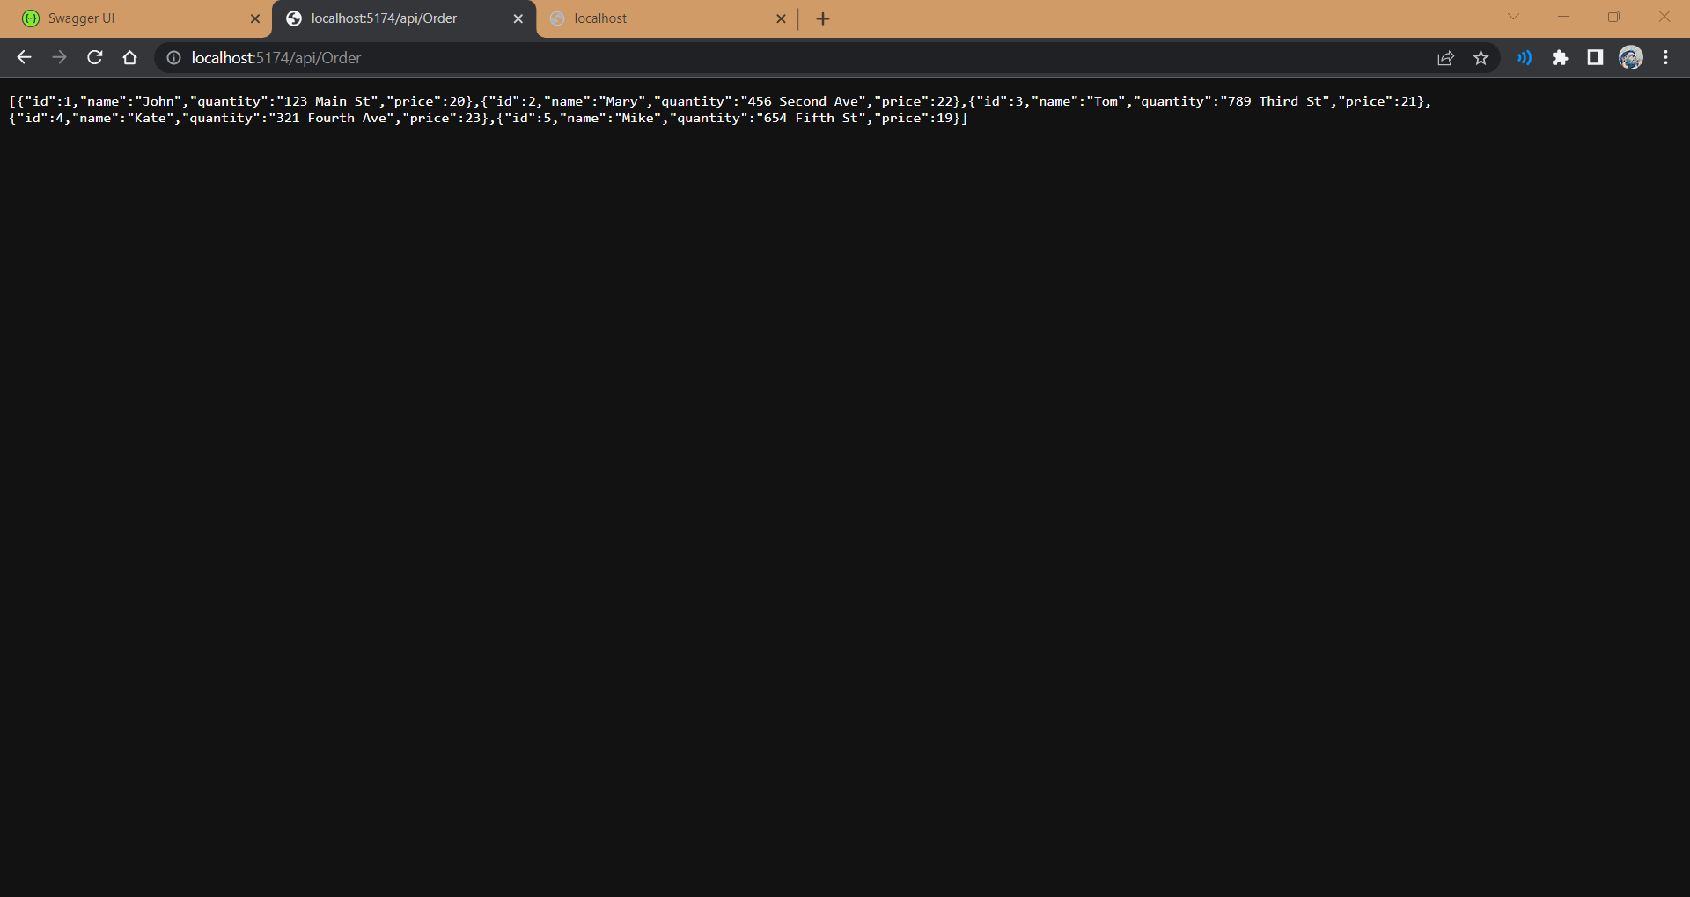
Output

Slide 54
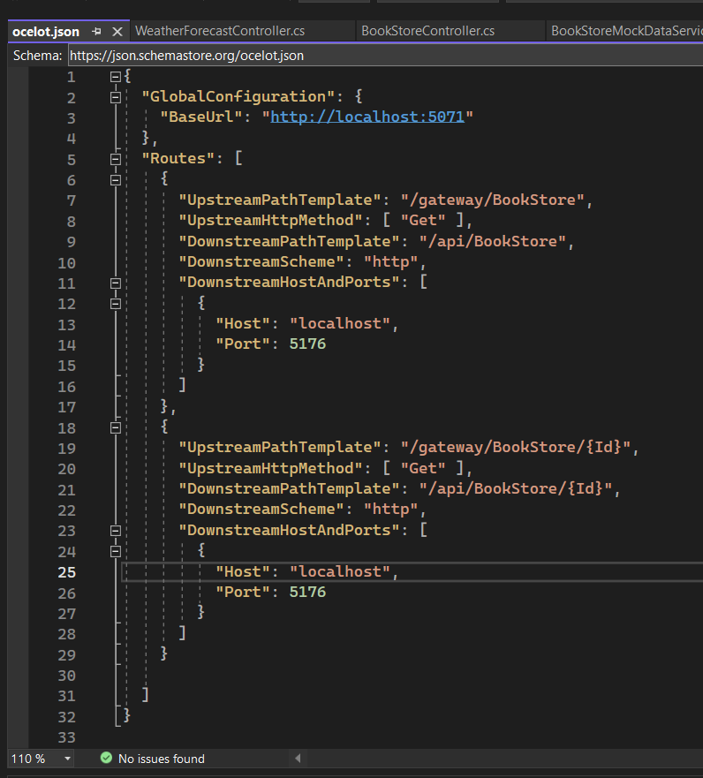
PRODUCT MANAGEMENT IT20051020
ocelot.json

Slide 55
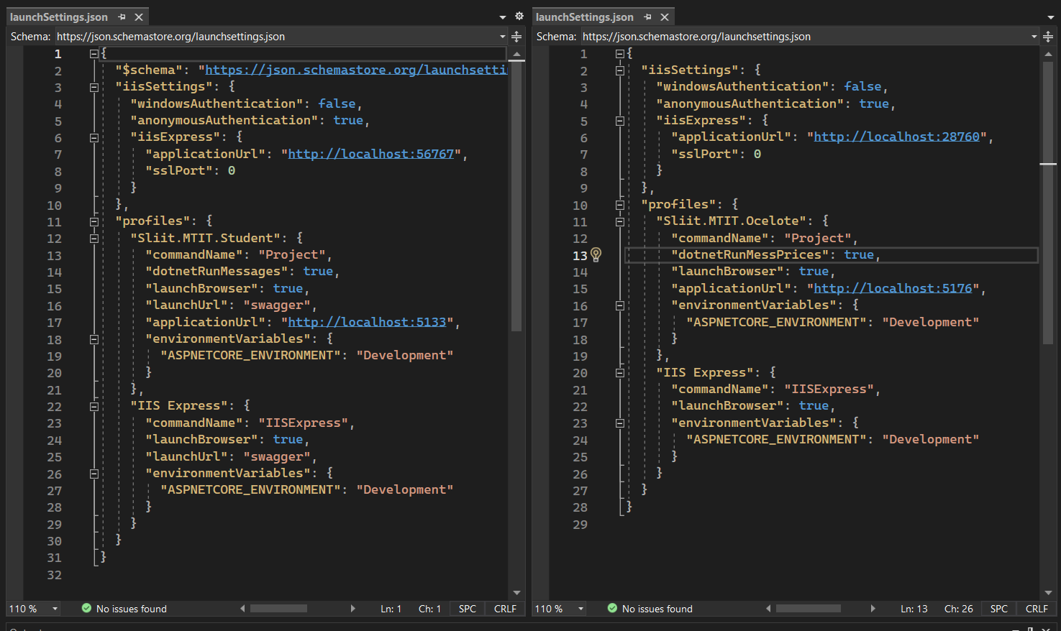
launchSettings.json

Slide 56

Output

Slide 57
THANK YOU !

